Slide 1
Exodus 19 & 20 Be Delivered

Slide 2
Hearing God
Bearing God’s Name
God’s Name
God’s Deliverance
God’s Presence
“Space Between”
God’s Care
Approaching God
God’s Power
God’s Expectation

Slide 3
19 On the third new moon after the people of Israel had gone out of the land of Egypt, on that day they came into the wilderness of Sinai. ² They set out from Rephidim and came into the wilderness of Sinai, and they encamped in the wilderness. There Israel encamped before the mountain, ³ while Moses went up to God. The Lord called to him out of the mountain, saying, “Thus you shall say to the house of Jacob, and tell the people of Israel: ⁴ ‘You yourselves have seen what I did to the Egyptians, and how I bore you on eagles' wings and brought you to myself.

Slide 4
⁵ Now therefore, if you will indeed obey my voice and keep my covenant, you shall be my treasured possession among all peoples, for all the earth is mine; ⁶ and you shall be to me a kingdom of priests and a holy nation.’ These are the words that you shall speak to the people of Israel.” ⁷ So Moses came and called the elders of the people and set before them all these words that the Lord had commanded him.

Slide 5
A Covenant Struck
Now therefore, if you will indeed obey my voice and keep my covenant, you shall be my treasured possession among all peoples, for all the earth is mine; ⁶ and you shall be to me a kingdom of priests and a holy nation.’
'We will do everything the Lord has said.' So Moses brought their answer back to the Lord."

Slide 6
How were the people suppose to prepare themselves for God’s presence?
What were the consequences for not following God’s instruction?
What character of the LORD did he want to reveal about himself?

Slide 7
You shall not bear the LORD’s name in vain.
The verb Tissa [nasa] mean’s to bear, endure, or carry a burden. In various other parts of the Torah, it describes physical carrying, bearing responsibility, or lifting up something or someone as significant.
Exodus 28:29 So Aaron shall bear the names of the sons of Israel in the breastpiece of judgment on his heart, when he goes into the Holy Place, to bring them to regular remembrance before the Lord.

Slide 8
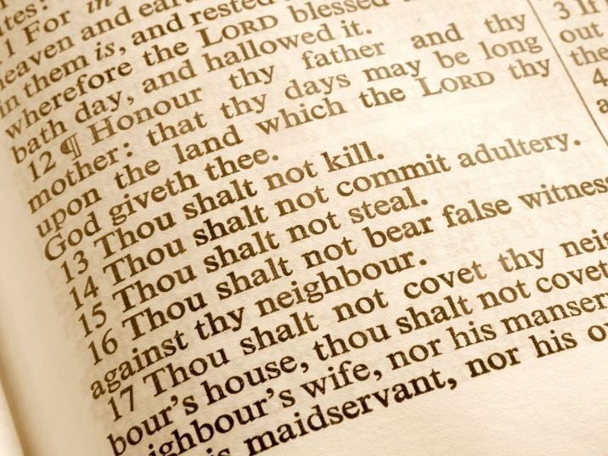

Slide 9
What is the purpose of the law?
To establish a covenant relationship:
Exodus 19:5-6
To guide righteous living:
Deuteronomy 6:24-25
To set Israel apart from other nations:
Leviticus 20:24-26
To reveal the holy nature of God:
Leviticus 11:44-45

Slide 10
How did the people respond to the “10 Words”
Exodus 24 ³ Moses came and told the people all the words of the Lord and all the rules. And all the people answered with one voice and said, “All the words that the Lord has spoken we will do.”
Nehemiah 8 ¹² And all the people went their way to eat and drink and to send portions and to make great rejoicing, because they had understood the words that were declared to them.

Slide 11
Book | Description
Exodus | Song of victory over Pharaoh, king of Egypt
Exodus | Food; Sabbath; opposing Moses; water from rock
Exodus | Joshua wins battle with Amalekites
Exodus | Moses' family (conflict)
Exodus | Moses' leadership burden
Exodus | Assisted by Midianite kin (Jethro)
Exodus | Arrival at Sinai
Exodus | Sinai Narratives
Numbers | Departure from Sinai Exodus
Numbers | Assisted by Midianite kin (Hobab)
Numbers | Moses' leadership burden
Numbers | Moses' family (conflict)
Numbers | Joshua and Caleb; battle with Amalekites/Canaanites lost
Numbers | Sabbath; opposing Moses/Aaron; water from rock; food?
Numbers | Springs of water provided
Numbers | Song of victory over Sihon, king of Ammon

Slide 12
