Slide 1
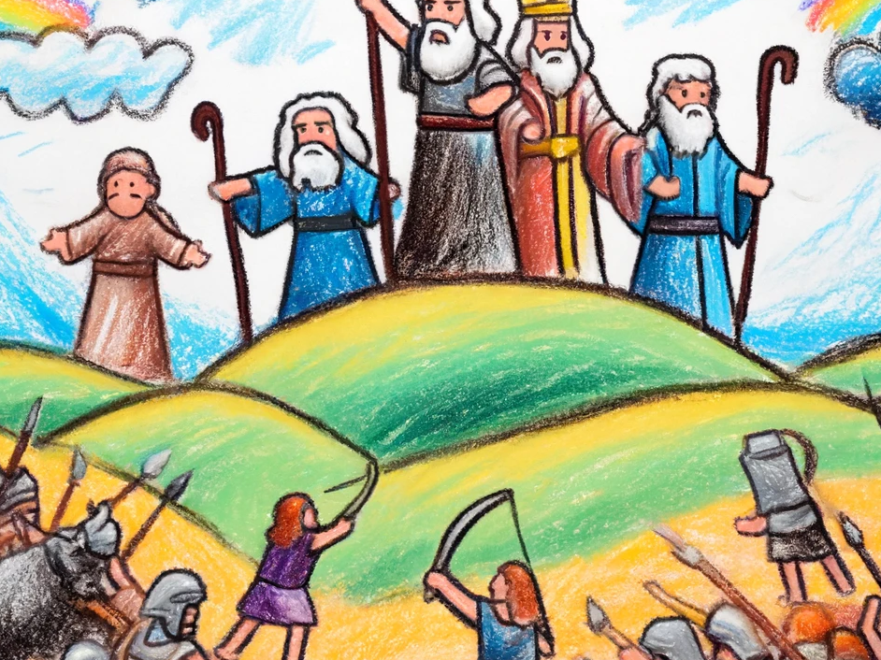
Exodus 17 & 18 Be Delivered

Slide 2
Criteria | Question | Likely Lament | Likely Complaint
Direction of Statement | To whom or what is the statement directed? | Directed at God or a higher power | Directed at people, self, or circumstances
Content and Focus | What is the focus of the statement? What is being expressed? | Focus on expressing grief, seeking understanding or solace | Focus on dissatisfaction with circumstances, without seeking deeper understanding
Tone and Emotion | What is the emotional tone of the statement? | Respectful, sorrowful, seeking connection | Frustrated, bitter, or resentful
Outcome or Intent | What does the speaker hope to achieve with the statement? | Seeking relief, comfort, or divine intervention, with trust in a positive outcome | Expressing frustration or venting; lacks trust in positive outcomes, e.g., "You’ve brought us to die"
Is it a complaint? A wanderer’s guide to petitioning help.

Slide 3
Liminality: The Space Between
Liminal space is an in-between space. It can be defined as a space that is:
A threshold
A transitional space
A transformative space
A space where you don’t know what is coming, but where many things are possible soon.
Those in liminal space are often caught between what they were and what they will be:
A Graduate
An Apprentice
An Initiate
A Pilgram
A Fiancé

Slide 4
17:2 Therefore the people quarreled with Moses and said, “Give us water to drink.” And Moses said to them, “Why do you quarrel with me? Why do you test the Lord?” ³ But the people thirsted there for water, and the people grumbled against Moses and said, “Why did you bring us up out of Egypt, to kill us and our children and our livestock with thirst?” ⁴ So Moses cried to the Lord, “What shall I do with this people? They are almost ready to stone me.”

Slide 5
⁵And the Lord said to Moses, “Pass on before the people, taking with you some of the elders of Israel, and take in your hand the staff with which you struck the Nile, and go. ⁶Behold, I will stand before you there on the rock at Horeb, and you shall strike the rock, and water shall come out of it, and the people will drink.” And Moses did so, in the sight of the elders of Israel.

Slide 6
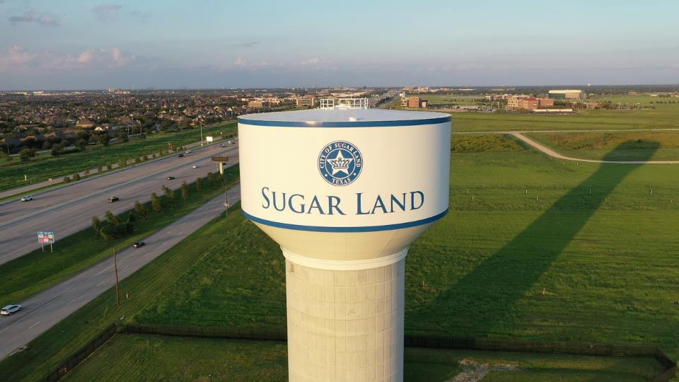

Slide 7
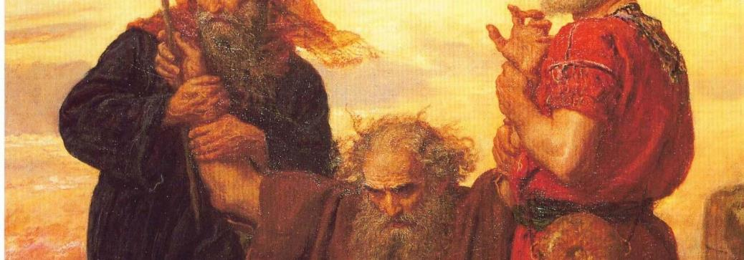
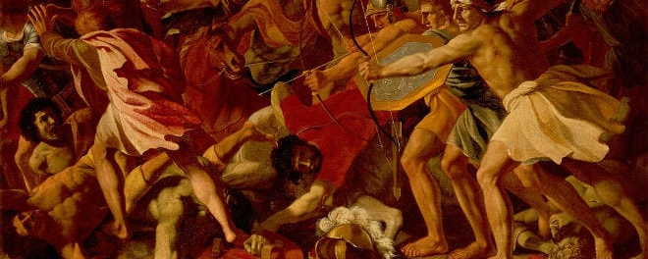

Slide 8
Compare Jethro & Pharoah
Nationality.
Attitude towards the Hebrews.
Treatment of Moses.
Recognition as Yahweh.

