Slide 1
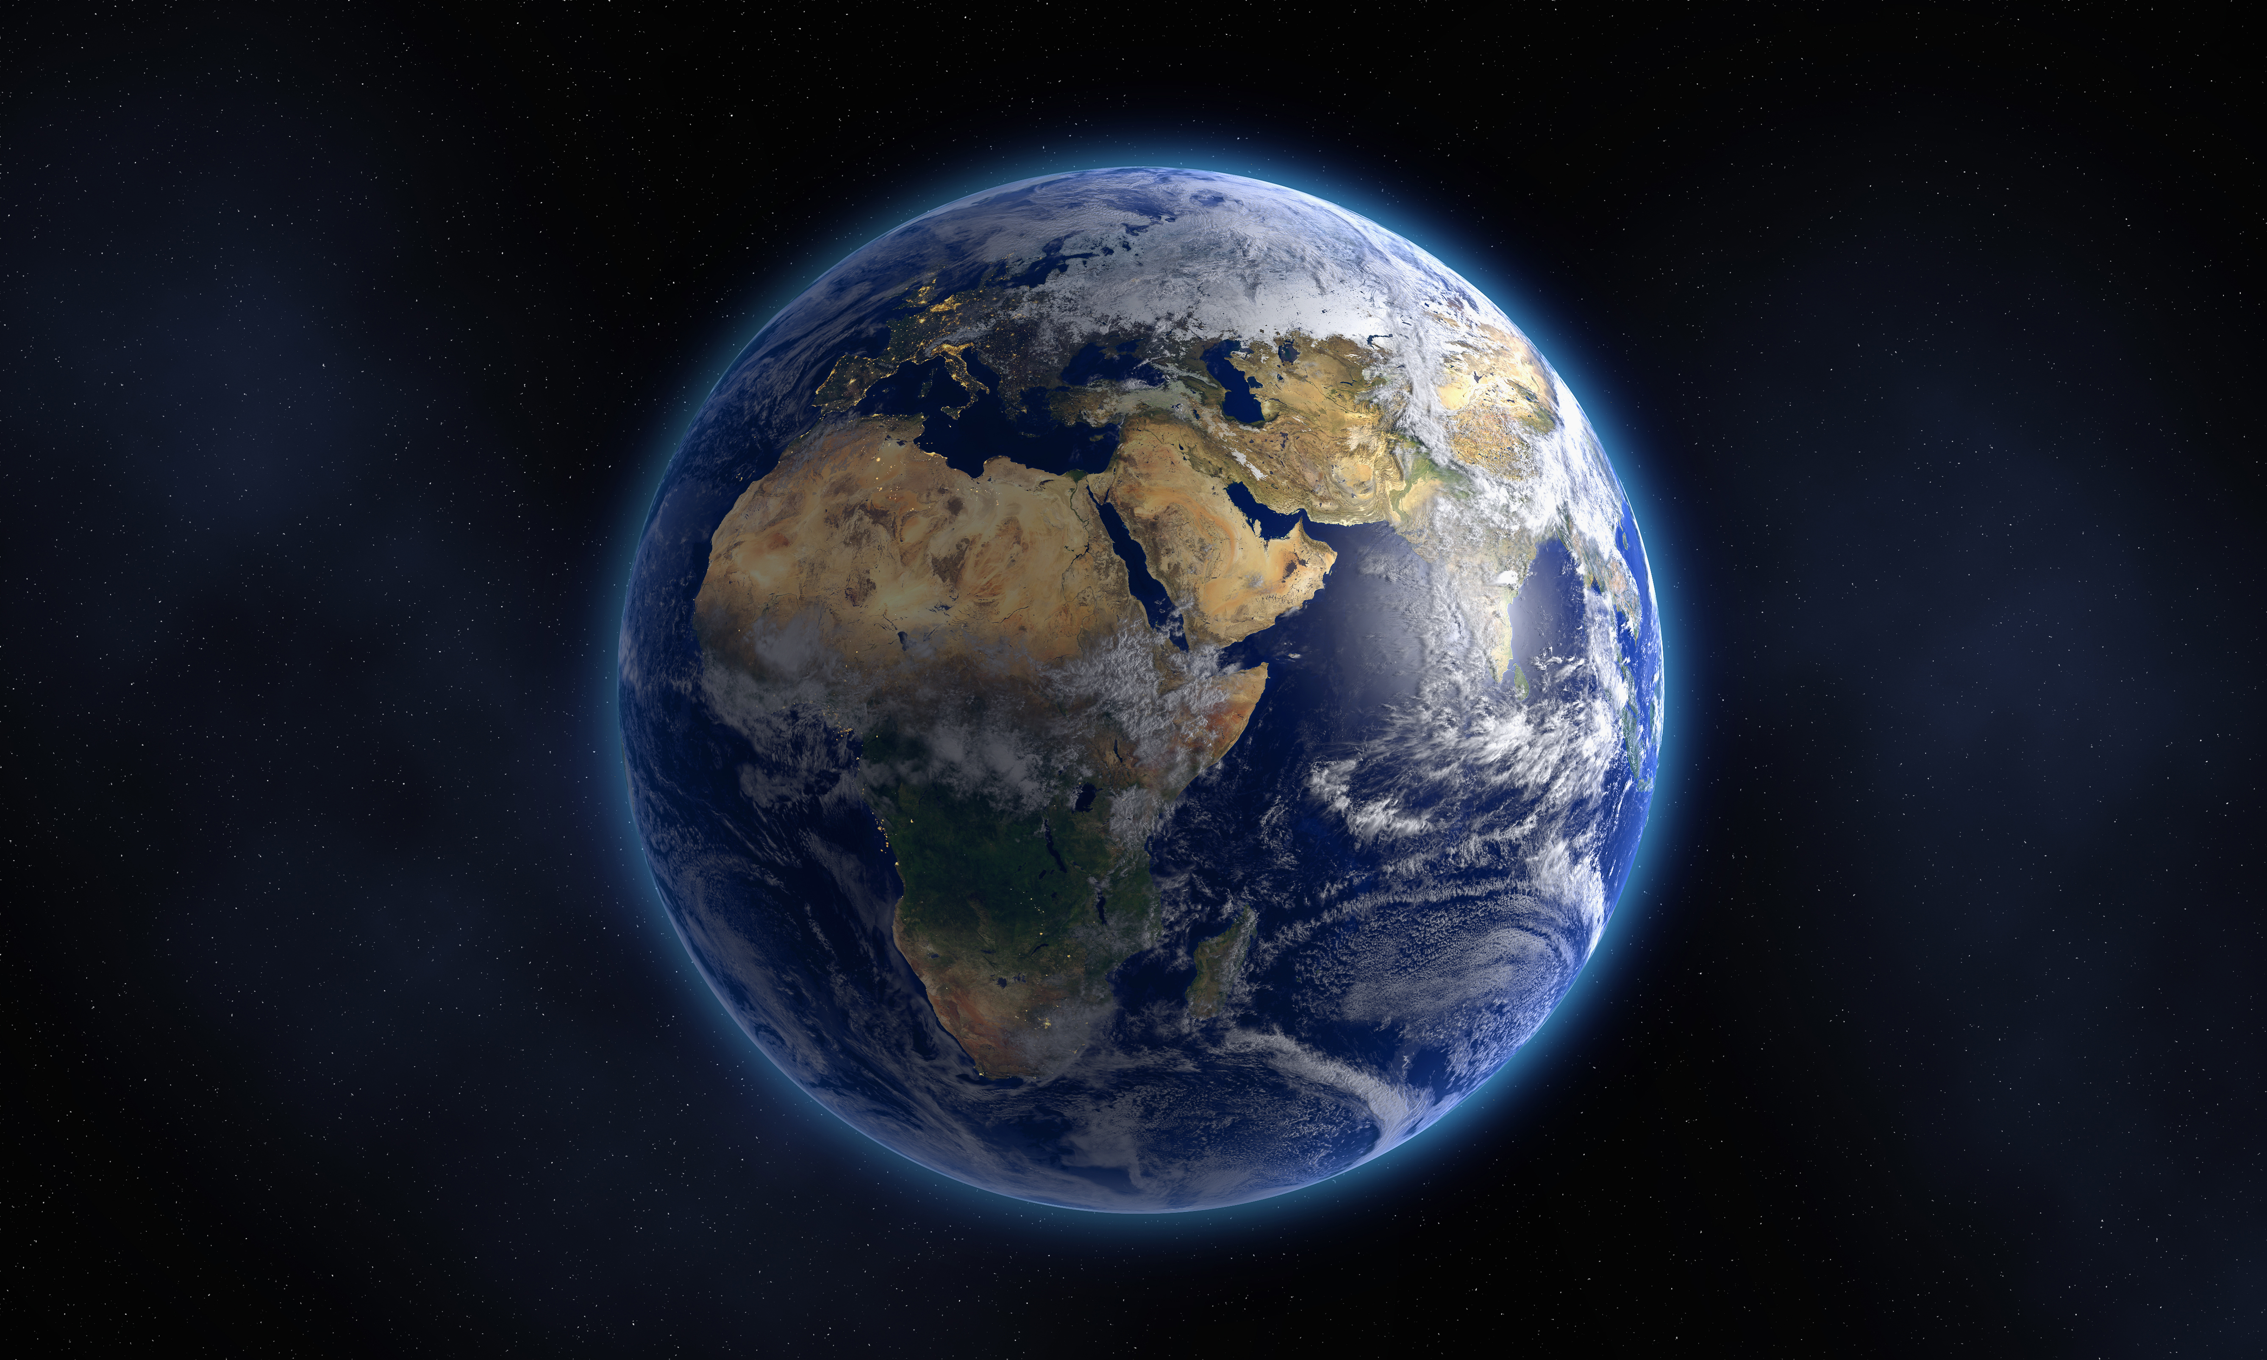
The book of genesis
A Study of the Pentateuch

Slide 2
God’s promise and providence Genesis 12:1-3
“Now the Lord said to Abram, Go forth from your country,
And from your relatives And from your father’s house,
To the LAND which I will show you;
And I will make you a great NATION,
And I will bless you, And make your name great;
And so you shall be a blessing;
And I will bless those who bless you,
And the one who curses you I will curse.
And in you ALL the FAMILIES of the earth will be BLESSED.”

Slide 3
God’s promise and providence Genesis 15:13-16
“God said to Abram, ‘Know for certain that your descendants will be strangers in a land that is not theirs, where they will be enslaved and oppressed four hundred years. But I will also judge the nation whom they will serve, and afterward they will come out with many possessions. As for you, you shall go to your fathers in peace; you will be buried at a good old age. Then in the fourth generation they will return here, for the iniquity of the Amorite is not yet complete.”
Notes:
“God said to Abram, ‘Know for certain that your descendants will be strangers in a land that is not theirs, where they will be enslaved and oppressed four hundred years. But I will also judge the nation whom they will serve, and afterward they will come out with many possessions. As for you, you shall go to your fathers in peace; you will be buried at a good old age. Then in the fourth generation they will return here, for the iniquity of the Amorite is not yet complete.”
Your Descendants – Abram was yet w/o child
Enslaved and oppressed four hundred years – Israel in Egypt
Afterward they will come out with many possessions – Exodus

Slide 4
Prequal to exodus
Joseph Reveals Himself to His Brothers
Genesis 45:1-11
Jacob’s Joyful Journey to Egypt
Genesis 45:24 – 46:7
Joseph’s Family Settles in Goshen
Genesis 47:1-12
Family of Israel Thrive in Land of Goshen
Genesis 47:27-28

Slide 5
God’s promise and providence
Abraham – Isaac – Jacob – 12 sons (Joseph + Judah) – A Nation
Gen. 46:27 “…all the persons of the house of Jacob, who came to Egypt, were seventy.”
Gen. 47:27 “Now Israel lived in the land of Egypt, in Goshen, and they acquired property in it and were fruitful and became very numerous.”
Ex. 1:9 “Now a new king arose over Egypt, who did not know Joseph. He said to his people, “Behold, the people of the sons of Israel are more and mightier than we.”
Ex. 12:37 “Now the sons of Israel journeyed from Rameses to Succoth, about six hundred thousand men on foot, aside from children.”
Notes:
Genesis ends with TRANSITION from singular family of
Abraham – Isaac – Jacob – 12 sons (Joseph + Judah)
To NATION OF ISRAEL
Promise to Abram to Exodus span half a millenia

Slide 6
How might understanding God’s promise and providence impact the way we navigate challenges in our lives today?

Slide 7
Timeline of genesis 1-12
Creation
Unknown - ~ 4000 BC
The Garden of Eden
Unknown to ~ 4000 BC
The Fall of Man
Unknown - ~ 4000 BC
Cain Kills Abel
~ 4000 – 3870 BC
Adam to Noah
~ 3870 – 2814 BC
The Great Flood
~ 2214 BC
Covenant Rainbow
Tower of Babel
Abram Born
~ 2000 BC

Slide 8
ETERNAL VS. TEMPORAL PERSPECTIVE
Grants His Children Proper Perspective:
Creation → Abraham ≈ 2,000 Years
Abraham (Calling + Promise) → Exodus ≈ 500-700 Years
II Peter 3:8 – “But do not let this one fact escape your notice, beloved, that with the Lord one day is like a thousand years, and a thousand years like one day.”
Notes:
Why is it so important for God’s people to understand this?
In Genesis …
What were consequences when they didn’t?
Esau Example
Hebrews 12:16 “that there be no immoral or godless person like Esau, who sold his own birthright for a single meal. For you know that even afterwards, when he desired to inherit the blessing, he was rejected, for he found no place for repentance, though he sought for it with tears.”
What were the consequences when they did?
Today…

Slide 9
ETERNAL VS. TEMPORAL PERSPECTIVE
God’s Vision of World + Future Events is Crystal Clear
Jeremiah 29:11 “For I know the plans that I have for you’, declares the Lord, ‘plans for welfare and not for calamity to give you a future and a hope.’”
Psalm 139:4 “Even before there is a word on my tongue, Behold, O Lord, You know it all.”
Hebrews 4:13 “And there is no creature hidden from His sight, but all things are open and laid bare to the eyes of Him with whom we have to do.”
Notes:
Our focus today is NO DIFFERENT
NO LESS SCARY
NO LESS UNCERTAIN
NO LESS VOLITILE
NO LESS WORLDLY
MAN’S HEART IS NO LESS SET ON EVIL
LUST OF THE FLESH IS NO LESS PREVALENT
LUST OF THE EYES IS NO LESSP REVALENT
PRIDE OF LIFE IS NO LESS PREVALENT

Slide 10
Trust + submit to God’s will
Deut. 31:6 “Be strong and courageous, do not be afraid or tremble at them, for the Lord your God is the one who goes with you. He will not fail you or forsake you.”
Heb. 13:5-6 “…“I will never desert you, nor will I ever forsake you…”
Notes:
We can only TRUST and maintain an Eternal Perspective → S
Submission to God’s Will

Slide 11
Important Verses and themes -Creation-
Disorder, Darkness, & Emptiness → Order, Light, & Flourishing Life
Gen. 1:1-2
Creates Mankind
Gen. 1:26 – Reflection of God’s Character [Relationship]
Gen. 1:28 – Appointed as Representatives to Rule [Purpose]
Gen. 1:28 – God Blesses Man [Perfect Order]
Notes:
Disorder, Darkness, Chaos & Emptiness → Order, Light, Beauty, Goodness & Flourishing Life
1:1-2
Culmination of God’s PERFECT creation is MANKIND
Reflection of God’s Character out into the world [Relationship]
Appointed as Representatives to Rule [Purpose]
Be fruitful – fill the earth
Subdue Earth – rule over it
Harness creation’s potential and create beauty and order
God Blesses Man [Perfect Order]
Gives them EVERYTHING they need to start building this new world
Blessings exist as long as mankind
TRUSTS in God in this created Sabbath
Submit to His will
Allow God to define what is GOOD and EVIL
This makes sense: Creator of all that is ordered and perfect should define the standard

Slide 12
Important Verses and themes -mankind’s choice-
Humans Have a Choice
How are they going to live out this divine purpose to be fruitful, multiply, rule over, and subdue the Earth?
Trust God ↔ Seize Autonomy and Define Good/Evil for Themselves
Tree of Knowledge of Good and Evil
Stakes are High!
To Rebel Against God ═ Embrace Death
Notes:
Humans Have a Choice
How are they going to live out this divine purpose to be fruitful, multiply, rule over, and subdue the Earth?
Represented by the Tree of Knowledge of Good/Evil
Up until now – God has provided/defined what is good and what is NOT good
God has given mankind the dignity and FREEDOM of choice
Trust God’s Definition of Good/Evil OR Seize Autonomy and Define Good/Evil for Themselves
Stakes are High!
To Rebel Against God ═ Embrace Death
Your turning away from the GIVER OF LIFE HIMSELF!

Slide 13
Important Verses and themes -Satan’s lie-
Satan Enters Story - Tells a different story about the Tree and mankind's CHOICE
Gen. 3:1-6 – “You surely will not die! For God knows that in the day you eat from it your eyes will be opened, and you will be like God, knowing good and evil.” When the woman saw that the tree was good for food, and that it was a delight to the eyes, and that the tree was desirable to make one wise, she took the fruit and ate; and she gave also to her husband with her, and he ate.”
Tragic Irony – The humans are ALREADY like God – They were made to reflect God’s image!
Notes:
Chapter 3 – Satan Enters Story
Creature in rebellion against God
Desires to lead mankind in same rebellion and to their deaths
Tells a different story about the Tree and mankind's CHOICE
Seizing the knowledge of Good/Evil will NOT bring DEATH, but it is actually the way to LIFE and becoming like God themselves!
Tragic Irony – The humans are ALREADY like God – They were made to reflect God’s image!
Do not trust your Creator, Do not surrender yourself to God’s blessed will
Perfection: Not obtained through God – through yourself
Purpose: Do what is pleasing in your sight
Relationship: God is an obstacle to your happiness – which is paramount above all else
Instead of trusting in God – humans rebel, seize autonomy and take the knowledge of Good/Evil for themselves
We will do what is right in our OWN eyes – not what is right defined by our HOLY CREATOR of ALL THAT IS GOOD & PERFECT

Slide 14
Important Verses and themes -Tragedy of sin-
Relationships Broken
Man and Woman (Gen. 3:7)
Mankind and their Creator (Gen. 3:10)
Purpose on Earth Now Entangled with Hardships from Sin
Be fruitful, multiply, and fill the earth (Gen. 1:28) ↔ Woman’s Pain (3:16)
Subdue the Earth (Gen. 1:28) ↔ Cursed Ground (3:17-19)
Death (Gen. 3:19; 22-23)
Notes:
1st Casualty of Sin
Relationships Broken
Man and Woman (Gen. 3:7)
Suddenly realize how vulnerable they are
Can’t even trust each other
Make clothes and hide their body from one another
Mankind and their Creator (Gen. 3:10)
They run and hide from God
When found – blame-shifting about who rebelled first
God’s Response
Purpose
Every aspect of their lives at home and in field will be fraught with grief and pain because of their rebellion all leading to their death.
Be fruitful, multiply, and fill the earth (Gen. 1:28) ↔ Woman’s Pain (3:16)
Subdue the Earth (Gen. 1:28) ↔ Cursed Ground (3:17-19)
Death (Gen. 3:19; 22-23)
Unholy, unclean, removed from the presence of God
Sound harsh?
Ask – what is the way of man?

Slide 15
Important Verses and themes -wounded victor-
Despite apparent victory – Satan is destined to be defeated (Gen. 3:14-15)
Wounded Victor Prophecy
Seed (Descendant) will come from woman who will deliver a lethal strike to the snake’s head
Victory will come at great cost – Snake will deliver a lethal strike to the descendant’s heel as it is being crushed
God’s Immediate Response is one of Grace and Mercy
Notes:
Despite apparent victory – destined to be defeated (Gen. 3:14-15)
Wounded Victor Prophecy
Promises ONE DAY a seed (Descendant) will come from woman who will deliver a lethal strike to the snake’s head
Victory will come at great cost – Snake will deliver a lethal strike to the descendant’s heel as it is being crushed
God’s Immediate Response of Grace and Mercy
Humans have just
Rejected God’s blessing
Rejected the perfect order of creation
Rejected their purpose as His divine image bearer
Rejected the 7th day Eden Rest
God IMMEDIATELY promises to RESCUE them

Slide 16
Trust + submit to God’s will
How might understanding God’s promise and providence impact the way we navigate challenges in our lives today?
He asks man to trust Him – moment by moment
God’s Children KNOW His Promises will be Fulfilled.
Examples From our Genesis Study
Notes:
He asks man to trust Him – moment by moment
God’s Promises will be Fulfilled.
Examples from our study
Noah
Abram
Isaac
Jacob
Joseph

Slide 17
Trust + submit to God’s will
Noah Warned/Promised
6:13-14
Noah’s Response
6:22
Abram Called Forth
12:1
Abram’s Response
12:4
Isaac Submits
22:7
Jacob Promised
28:15
Jacob’s Response
28:16
Joseph Submits – 50:20-21
Notes:
He asks man to trust Him – moment by moment
God’s Promises will be Fulfilled.
Examples from our study
Noah
Abram
Isaac
Jacob
Joseph

Slide 18
Spiritual parallels
We too are Strangers in a Foreign Land
Gen. 15:13 ↔ Phil.3:20; Eph.2:19
God calls us to trust Him
Adam/Eve, Noah, Abram, Isaac, Jacob, Joseph ↔ Matt. 11:28-30
God promises deliverance
Adam/Eve (Gen.3:15); Abram (12:1-3); Isaac (22:8); Jacob (28:13-15); Joseph (45:5); Judah (49:8-10)
Mark 16:15-16 “And He said to them, “Go into all the world and preach the gospel to all creation. He who has believed and has been baptized shall be saved; but he who has disbelieved shall be condemned.”
Notes:
How does God promise his children deliverance today?
What are some other spiritual parallels?
We are a nation of God’s people (the church)
Eph. 2:19 “So then you are no longer strangers and aliens, but you are fellow citizens with the saints, and are of God’s household…”
We have been given an inheritance (heaven)
Hebrews 9:15 “For this reason He is the mediator of a new covenant, so that, since a death has taken place for the redemption of the transgressions that were committed under the first covenant, those who have been called may received the promise of the eternal inheritance.”
We have been delivered victory from spiritual enslavement
Rom. 6:17-18 “But thanks be to God that though you were slaves of sin, you became obedient from the heart to that form of teaching to which you were committed, and having been freed from sin, you became slaves of righteousness.

