Slide 1
Are You “Sold Out” to Jesus?

Slide 2
What will become of our children?
Will they obey the Gospel?
Will they remain faithful to Christ and follow Him obediently?
Where is my future spouse?
Will they ever show up?
What will become of my health?
Will I go deaf or lose my mind?

Slide 3
Who will take care of me?
Will I live the last few years abandoned, slumped over in a wheelchair at some nursing home?
What will become of my marriage?
Will we ever trust each other again?
Will we laugh, play, pray or ever talk again?
Will it be dissatisfying for the next thirty years?”

Slide 4
He is Showing us His Sovereign Authority
Immediately he made his disciples get into the boat and go before him to the other side, to Bethsaida, while he dismissed the crowd. And after he had taken leave of them, he went up on the mountain to pray. And when evening came, the boat was out on the sea, and he was alone on the land. (Mark 6:45-46)
He “made” is constraining, compelling, forcing His disciples to get in the boat.
“To go ahead of Him,” implying Jesus would join them later. (vs. 45)
Sending is to set free, release–sometimes used of a divorce or the releasing of a prisoner.
- “While He Himself was sending the crowd away.

Slide 5
When the people saw the sign that he had done, they said, “This is indeed the Prophet who is to come into the world!” Perceiving then that they were about to come and take him by force to make him king, Jesus withdrew again to the mountain by himself. (John 6:14-15)
Psalm 115:3, ”Our God is in the heavens; He does whatever He pleases.”
God does as He pleases, only as He pleases and always as He pleases!
“After bidding them farewell, He left for the mountain to pray.” (Vs. 46)

Slide 6
2. The Complete Knowledge of Jesus
And when evening came, the boat was out on the sea, and he was alone on the land. (Mark 6:47)
And he saw that they were making headway painfully, for the wind was against them. And about the fourth watch of the night he came to them, walking on the sea. He meant to pass by them, (Mark 6:48)

Slide 7
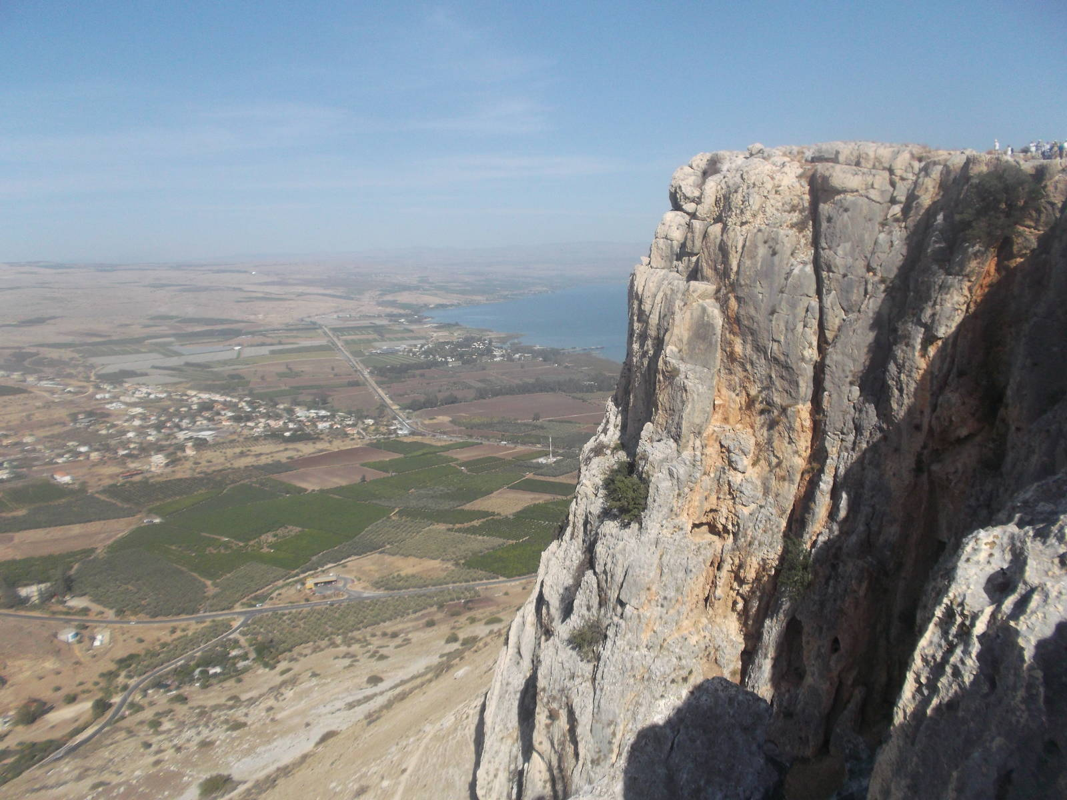

Slide 8
Disobedience might have resulted in:
A full stomach,
A warm bed in someone’s home,
An opportunity for real rest,
And a time to be refreshed with friends and family!
Because of obedience:
They are wet, tired, in pain, straining to stay alive,
They are exhausted and now forced to remain awake all night long.

Slide 9
“Seeing Them”

Slide 10
O LORD, you have searched me and known me!
You know when I sit down and when I rise up;
You discern my thoughts from afar.
You search out my path and my lying down
and are acquainted with all my ways.
Even before a word is on my tongue,
behold, O LORD, you know it altogether. (Psalms 139:1-4)
And no creature is hidden from his sight, but all are naked and exposed to the eyes of him to whom we must give account. (Heb. 4:13)

Slide 11
Are You “Sold Out” to Jesus?

