Slide 1
Summer Recharge
Lessons from the Book of Zechariah

Slide 2
Hope & Encouragement Zechariah’s Visions
The Lord of Hosts…
sees and cares (ch.1)
crushes enemies (ch.1)
protects His people (ch.2)
cleanses the guilty (ch.3)
How will we do the work?

Slide 3
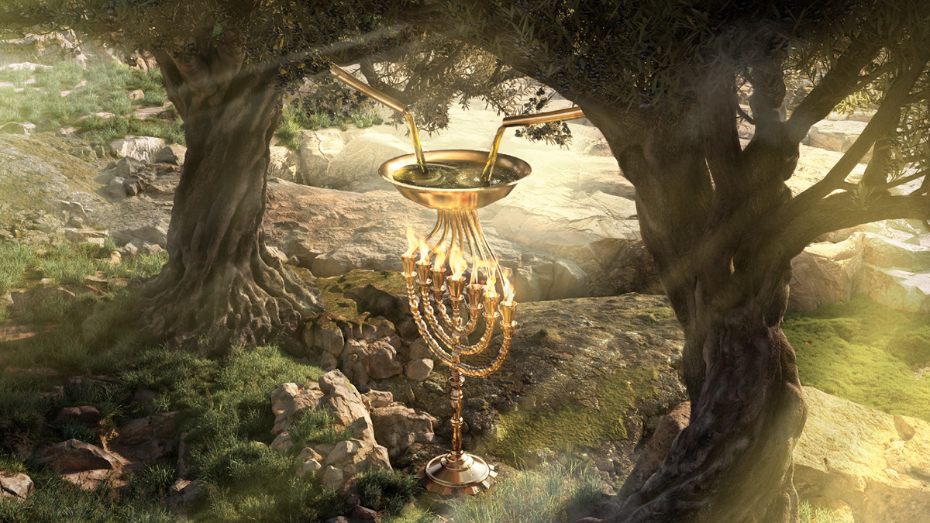
Vision #5 (Zech 4:1-14)
Lampstand fueled by two olive trees (2-3, 11-12)
God’s Spirit will bring the work to completion (6-10)
God works through leaders to fuel His people (13-14)
Message: God empowers His people to do the work.

Slide 4
Jesus the Anointed One
He provides the life-giving Spirit of God (John 7:37)
Apart from Him (the vine) we can do nothing (Jn 15:5)

Slide 5
God empowers us by His Spirit in Christ to do the work
It is Him, not us
Live by the Spirit
Celebrate small things

Slide 6
God Empowers
Summer Recharge in Zechariah

