Slide 2
Then Jesus said to him, “Put your sword back into its place. For all who take the sword will perish by the sword. Do you think that I cannot appeal to my Father, and he will at once send me more than twelve legions of angels? (Matthew 26:52–53 ESV)
He will not cry aloud or lift up his voice or make it heard in the street; a bruised reed he will not break, and a faintly burning wick he will not quench; he will faithfully bring forth justice. (Isaiah 42:2–3 ESV)
But let your adorning be the hidden person of the heart with the imperishable beauty of a gentle (meek) and quiet spirit, which in God’s sight is very precious. (1 Peter 3:4 ESV)

Slide 3
The Christian life demands courage, determination and ruggedness.
Because I will be called upon to crucify my flesh (Galatians 5:24),
To rip out an eye that causes me to stumble (Matthew 5:29)
To give a loud and clear “no” to temptation.
To call sin what it is.
To make hard choices, including putting God ahead of family (Matthew 10:37).

Slide 4
To preach God’s truth even when the audience does not want it (2 Timothy 4:2).
To admit when I am wrong.
To put the needs of my wife ahead of my own.
To sacrifice myself for the good of my family.
To remain true to God even when faced with torture or death (Revelation 2:10).

Slide 5
When is a person meek by Bible standards?
- You will see their self-control & inner discipline.
- You will sense their strength.
- Not dominated by fear.
- Not laziness or lack of imagination.

Slide 6
- They are not naïve, they understands what happens in the world,
- They know how evil people think and are prepared and ready for battle.
- They know when people are seeking to flatter them.
- They know when someone is trying to bait them into a trap.

Slide 7
“Or do you think I cannot appeal to My Father, and He will at once put at My disposal more than twelve legions of angels?” Matthew 26:53
“But all this has taken place that the Scriptures of the prophets might be fulfilled.” Matthew 26:56
“Blessed are you when others revile you and persecute you and utter all kinds of evil against you falsely on my account. Rejoice and be glad, for your reward is great in heaven, for so they persecuted the prophets who were before you.” Matt. 5:11-12
“Fret not thyself because of evildoers, neither be thou envious against them that work unrighteousness” (37:11).

Slide 8
“as sorrowful, yet always rejoicing; as poor, yet making many rich; as having nothing, and yet possessing all things”. 2 Corinthians 6:10
Christians have the character that guarantees a greater measure of happiness, peace, contentment, and stability.
Christians have the mindset that allows us to fully savor and enjoy the things and experiences of this life right now.
“Inherit the earth” is the same as saying that you belong in the kingdom of heaven (Matthew 5:3)

Slide 9
Then Peter said in reply, “See, we have left everything and followed you. What then will we have?” Jesus said to them, “Truly, I say to you, in the new world, when the Son of Man will sit on his glorious throne, you who have followed me will also sit on twelve thrones, judging the twelve tribes of Israel. And everyone who has left houses or brothers or sisters or father or mother or children or lands, for my name’s sake, will receive a hundredfold and will inherit eternal life. (Matthew 19:27–29 ESV)

Slide 10
Psa. 37:3-5 twice said that the meek trust in the Lord.
Psa. 37:4 said that they find their delight in the Lord.
Psa. 37:7 said that they wait expectantly for the Lord.
Psa. 37:9 said that they put their hope in the Lord.

Slide 11
Bible Definition of Meekness?
- Self-control & inner discipline.
- Spiritual Strength.
- Not dominated by fear.
- Not laziness or lack of imagination.

Slide 12
- Not naïve
- They know how evil people think and are prepared and ready for battle.
- They know when people are seeking to flatter them.
- They know when someone is trying to bait them into a trap.

Slide 13
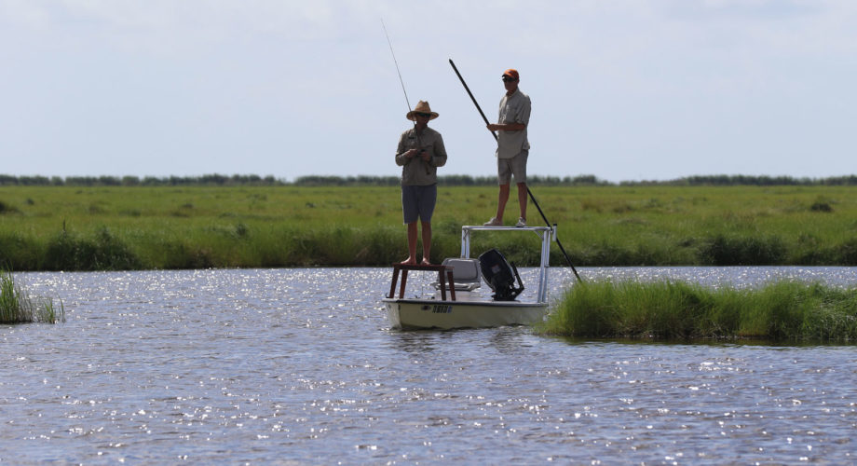
FOR THEY SHALL INHERIT THE EARTH

