Slide 1
Genesis 1:14 Then God said, “Let there be lights in the expanse of the heavens to separate the day from the night, and let them be for signs and for seasons and for days and years; ¹⁵ and let them be for lights in the expanse of the heavens to give light on the earth”; and it was so.
Notes:
Read the verse
God created the heavenly lights (sun, moon, and stars) to mark time – signs and seasons.
Cycles and rhythms of days, weeks, months and years was created by God for a purpose.
We experience that in our lives (holidays approaching), and God built it in to the Law of Moses.
Remember that the cornerstone of the Hebrew calendar was the Sabbath—the weekly rest and remembrance of what God had done for His people on every seventh day.
But… (next slide)

Slide 2
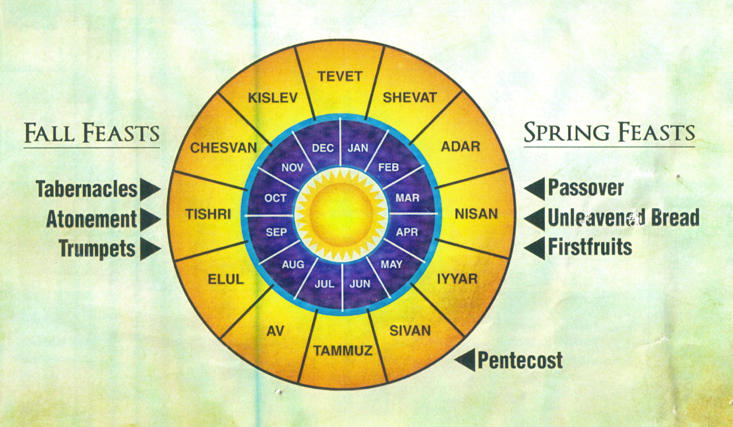
Holy Days in the Law of Moses
God wants His people to stop, reflect, and worship.
God was telling His people a story about His salvation.
Notes:
God made a calendar that starts in the Spring (when they came out of Egypt), with Passover kicking off three consecutive feasts – Unleavened Bread for seven days and Firstfruits on the first day of the week after the Feast of Unleavened Bread begins.
In early Summer, there is Pentecost (fifty days after Passover) also known as the Feast of Weeks (7 weeks after Passover)
Then in the Fall, in the seventh month of the year, there were three final appointed days—the Day of Trumpets, leading up to the Day of Atonement, and then the Feast of Tabernacles as the final Holy Day on the calendar.
There are a couple general lessons we would take from this:
One is that God always wanted His people to stop on a regular basis to reflect and to worship—even to gather with others in order to do that.
The other, though, is that these rhythms of the year point to a bigger timeline, a larger story that God wanted His people to be telling themselves repeatedly. A story that would remind them of what He had done for them, and remind them who they were.
Let’s look at the last feast how it fits into the story of God’s salvation.
As Alex said earlier, we are directing our thoughts this morning to the taking of the Lord’s Supper. So after we look at this particular feast, we’ll sing a song then prepare our minds for communion by looking at how all these appointed days tell the story we tell ourselves in the taking of the Lord’s Supper.

Slide 3
In This Tent We Rejoice
The Feast of Tabernacles
Notes:
Like some of the other feasts, this one is referred to in a few different ways.
It is called the feast of tabernacles, a word that really just means tent. And this is not a reference to the Tabernacle—the holy tent where God dwelled--but a reference to tents.
That’s why it’s also translated in some versions as the Feast of Booths. The Booths are the tents, or temporary shelters.

Slide 4
Feast of Tabernacles (Ingathering)
Celebrates the full harvest, anticipates winter rains (Exodus 34:22; Deuter. 16:13-15)
Notes:
But the very first reference to this feast in the Torah calls it the Feast of Ingathering.
Exodus 34:22 - You shall celebrate the Feast of Weeks, that is, the first fruits of the wheat harvest, and the Feast of Ingathering at the turn of the year.
It’s called this because it marked the end (turn) of the agricultural year, and the culmination of the harvest.
Remember that these feasts were tied to the agricultural cycle in Israel, something this ancient society would have been dependent on and always aware of.

Slide 5
Festivals Celebrating the Agricultural Seasons
Rainy Season
Barley
Olives/ Grapes
Wheat
Notes:
After the harvests of grain earlier in the year, the Fall is when the harvest of the vine comes in—the olives and grapes—which are abundant and hugely important in Israel.
Also, the grain takes time to process (thresh) before it is gathered into the barns. So the 7th month is when the final crops are harvested AND the grain is finally brought in.
Deuteronomy 13:13-15 - “You shall celebrate the Feast of Booths seven days after you have gathered in from your threshing floor and your wine vat; 14 and you shall rejoice in your feast, you and your son and your daughter and your male and female servants and the Levite and the stranger and the orphan and the widow who are in your towns. 15 Seven days you shall celebrate a feast to the Lord your God in the place which the Lord chooses, because the Lord your God will bless you in all your produce and in all the work of your hands, so that you will be altogether joyful.
Notice the language of celebration/joy. What joy it would be to bring it all in another year.
But the other thing going on at this “turn” of the year is that the seeds are in the ground and the people are waiting for the yearly rains. It basically never rains before the Feast of Ingathering, but the rain would come in the winter to restart the cycle of growth. So at this feast the people would be praying for and anticipating the rains to bring new life.
Deuteronomy 11:14-16 - that He will give the rain for your land in its season, the early and late rain, that you may gather in your grain and your new wine and your oil. 15 He will give grass in your fields for your cattle, and you will eat and be satisfied. 16 Beware that your hearts are not deceived, and that you do not turn away and serve other gods and worship them.

Slide 6
Feast of Tabernacles (Ingathering)
Celebrates the full harvest, anticipates winter rains (Exodus 34:22; Deuter. 16:13-15)
Remembers the wilderness wandering, people live in tents (Leviticus 23:33-43)
God’s Presence
God’s Provision
Notes:
Leviticus 23:34-43 - “Speak to the sons of Israel, saying, ‘On the fifteenth of this seventh month is the Feast of Booths for seven days to the Lord. 35 On the first day is a holy convocation; you shall do no laborious work of any kind. 36 For seven days you shall present an offering by fire to the Lord. On the eighth day you shall have a holy convocation and present an offering by fire to the Lord; it is an assembly. You shall do no laborious work. … 39 ‘On exactly the fifteenth day of the seventh month, when you have gathered in the crops of the land, you shall celebrate the feast of the Lord for seven days, with a rest on the first day and a rest on the eighth day. 40 Now on the first day you shall take for yourselves the foliage of beautiful trees, palm branches and boughs of leafy trees and willows of the brook, and you shall rejoice before the Lord your God for seven days. 41 You shall thus celebrate it as a feast to the Lord for seven days in the year. It shall be a perpetual statute throughout your generations; you shall celebrate it in the seventh month. 42 You shall live in booths for seven days; all the native-born in Israel shall live in booths, 43 so that your generations may know that I had the sons of Israel live in booths when I brought them out from the land of Egypt. I am the Lord your God.’”
Sabbath/assembly on Day 1, seven days of offerings, sabbath/assembly on Day 8.
They were to take foliage, make temporary shelters to live in for the duration of the feast. The branches were also used to celebrate (think pom-poms). All in memorial of their days in the wilderness, when the people lived in tents as they traveled toward the Promised Land.
A bit of an irony, but there joy for two things: God was with them, (still is). (progression from Yom Kippur)
And God was providing for everything they needed (and still is – see the harvest)

Slide 7
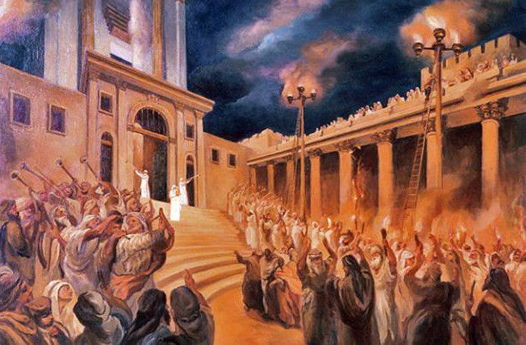
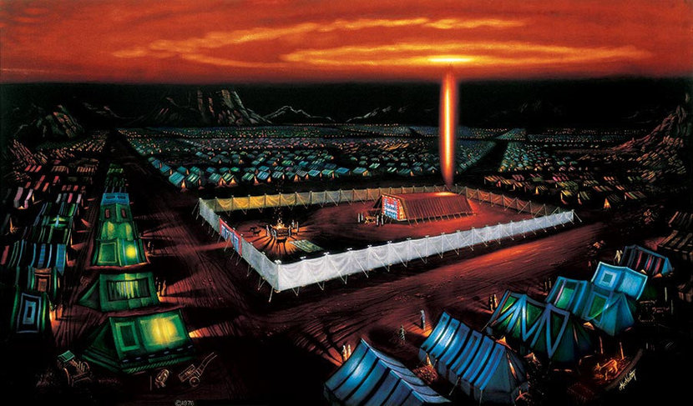
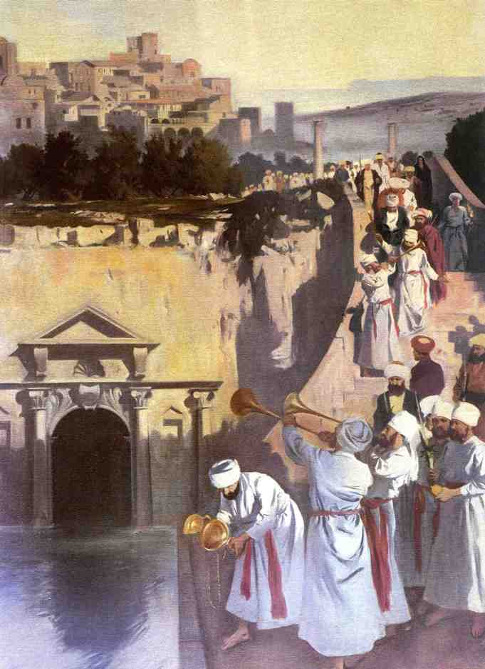
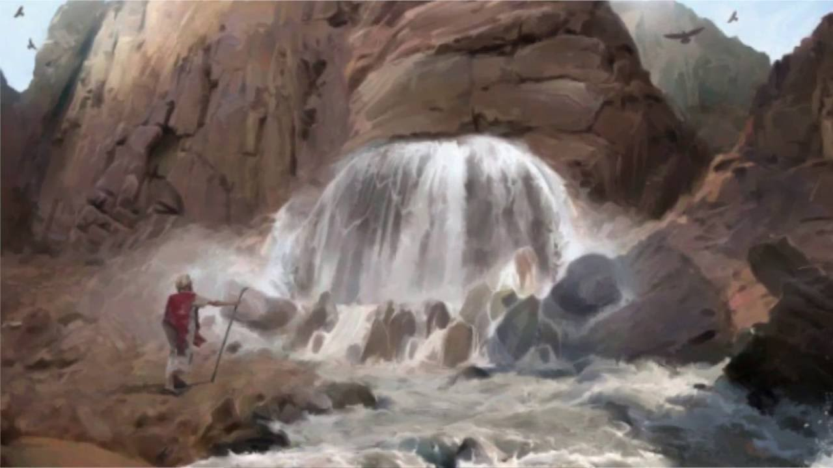
God’s Presence
God’s Provision
Notes:
What were demonstrations of God’s presence and provision in the wilderness?
Presence – the pillar of fire/cloud that rested on the tabernacle, moved with them.
Provision – the nourishment God gave them in barren wasteland, namely water (which is life) flowing from the rock.
These images came to have a strong association with this Feast, which became the most joyful of all the feast days celebrated by the people of Israel.
Over time, Jewish history tells us that two traditions developed in the celebration of the Feast of Tabernacles.
One was the ceremony of lights – the lighting of huge torch candelabras on big pillars, which would light up the entire city of Jerusalem. It recalled that fire in the wilderness, and the presence of God, guiding/protecting His people.
The other was the water-drawing ceremony, in which the High Priest would go down to the pool of Siloam and draw a pitcher of water, carry it back to the temple and pour it over the altar. It remembered the water from the rock in the wilderness, and also anticipated the rains they prayed would be poured out on their land in winter.
After the Temple was destroyed, the rabbis reflected on this celebration and said, “He who has not seen the rejoicing at the place of the water-drawing has never seen rejoicing in his life” (Talmud Sukkah 51b).

Slide 8
Feast of Tabernacles (Ingathering)
Celebrates the full harvest, anticipates winter rains (Exodus 34:22; Deuter. 16:13-15)
Remembers the wilderness wandering, people live in tents (Leviticus 23:33-43)
Chosen day for temple dedication, restarting worship (1 Kings 8:2; Ezra 3:1-5)
God’s Presence
God’s Provision
Notes:
The fact that this was the most joyful feast for the Jews is also apparent in Biblical history.
When Solomon built the temple for Jehovah— he chose this feast for the dedication.
1 Kings 6:38 - In the eleventh year, in the month of Bul, which is the eighth month, the house was finished…
1 Kings 8:1-2 - Then Solomon assembled the elders of Israel and all the heads of the tribes, the leaders of the fathers’ households of the sons of Israel, to King Solomon in Jerusalem, to bring up the ark of the covenant of the Lord from the city of David, which is Zion. 2 All the men of Israel assembled themselves to King Solomon at the feast, in the month Ethanim, which is the seventh month.
And when the exiles of Judah returned home and started rebuilding the temple and restoring temple worship, they chose this day
Ezra 3:1-4 - Now when the seventh month came, and the sons of Israel were in the cities, the people gathered together as one man to Jerusalem. 2 Then Jeshua the son of Jozadak and his brothers the priests, and Zerubbabel the son of Shealtiel and his brothers arose and built the altar of the God of Israel to offer burnt offerings on it, as it is written in the law of Moses, the man of God. 3 So they set up the altar on its foundation, for they were terrified because of the peoples of the lands; and they offered burnt offerings on it to the Lord, burnt offerings morning and evening. 4 They celebrated the Feast of Booths, as it is written, and offered the fixed number of burnt offerings daily, according to the ordinance, as each day required…

Slide 9
Feast of Tabernacles (Ingathering)
Celebrates the full harvest, anticipates winter rains (Exodus 34:22; Deuter. 16:13-15)
Remembers the wilderness wandering, people live in tents (Leviticus 23:33-43)
Chosen day for temple dedication, restarting worship (1 Kings 8:2; Ezra 3:1-5)
Anticipates the blessing of God in the Messianic kingdom (Zechariah 14:6-8; 16-19)
Notes:
The celebration of abundance previewed the Messianic Age:
Joel 2:23-27 - rejoice, O sons of Zion, And be glad in the Lord your God; For He has given you the early rain for your vindication. And He has poured down for you the rain, The early and latter rain as before.24 The threshing floors will be full of grain, And the vats will overflow with the new wine and oil.25 “Then I will make up to you for the years That the swarming locust has eaten, The creeping locust, the stripping locust and the gnawing locust, My great army which I sent among you. 26 “You will have plenty to eat and be satisfied And praise the name of the Lord your God, Who has dealt wondrously with you; Then My people will never be put to shame.27 “Thus you will know that I am in the midst of Israel, And that I am the Lord your God, And there is no other; And My people will never be put to shame.
The Feast itself was a preview of all nations worshipping God in His kingdom:
Zechariah 14:6-8 - In that day there will be no light; the luminaries will dwindle. 7 For it will be a unique day which is known to the Lord, neither day nor night, but it will come about that at evening time there will be light. 16-19 - Then it will come about that any who are left of all the nations that went against Jerusalem will go up from year to year to worship the King, the Lord of hosts, and to celebrate the Feast of Booths. 17 And it will be that whichever of the families of the earth does not go up to Jerusalem to worship the King, the Lord of hosts, there will be no rain on them. 18 If the family of Egypt does not go up or enter, then no rain will fall on them; it will be the plague with which the Lord smites the nations who do not go up to celebrate the Feast of Booths. 19 This will be the punishment of Egypt, and the punishment of all the nations who do not go up to celebrate the Feast of Booths.

Slide 10
John 7:2 Now the feast of the Jews, the Feast of Booths, was near.
^{John 7:37} Now on the last day, the great day of the feast, Jesus stood and cried out, saying, “If anyone is thirsty, let him come to Me and drink. ³⁸ He who believes in Me, as the Scripture said, ‘From his innermost being will flow rivers of living water.’”
³⁹ But this He spoke of the Spirit, whom those who believed in Him were to receive; for the Spirit was not yet given, because Jesus was not yet glorified.
^{John 8:12} Then Jesus again spoke to them, saying, “I am the Light of the world; he who follows Me will not walk in the darkness, but will have the Light of life.”
let him come to me and drink
From his
innermost being will flow rivers of living water
I am
the Light of the world
Notes:
Every year, the people rejoiced in the blessings of God who dwelled with them, anticipating more blessings to come, looking forward to a time when God would pour out the fullness of joy
John 1:14 – And the Word became flesh, and dwelt among us, and we saw His glory, glory as of the only begotten from the Father, full of grace and truth.

Slide 11
Feast of Tabernacles & Us
Celebrate God’s presence with us as we journey through the wilderness.
Jesus is the Light, guiding and protecting us.
Holy Spirit is the water, renewing and refreshing us.
Notes:
2 Corinthians 3:18 - But we all, with unveiled face, beholding as in a mirror the glory of the Lord, are being transformed into the same image from glory to glory, just as from the Lord, the Spirit.
4:6-7 - For God, who said, “Light shall shine out of darkness,” is the One who has shone in our hearts to give the Light of the knowledge of the glory of God in the face of Christ.7 But we have this treasure in earthen vessels, so that the surpassing greatness of the power will be of God and not from ourselves.
4:16-18 - Therefore we do not lose heart, but though our outer man is decaying, yet our inner man is being renewed day by day. 17 For momentary, light affliction is producing for us an eternal weight of glory far beyond all comparison, 18 while we look not at the things which are seen, but at the things which are not seen; for the things which are seen are temporal, but the things which are not seen are eternal.
5:1-5 - For we know that if the earthly tent which is our house is torn down, we have a building from God, a house not made with hands, eternal in the heavens. 2 For indeed in this house we groan, longing to be clothed with our dwelling from heaven, 3 inasmuch as we, having put it on, will not be found naked. 4 For indeed while we are in this tent, we groan, being burdened, because we do not want to be unclothed but to be clothed, so that what is mortal will be swallowed up by life. 5 Now He who prepared us for this very purpose is God, who gave to us the Spirit as a pledge.

Slide 12
In This Tent We Rejoice
We do not lose heart, but though our outer man is decaying, yet our inner man is being renewed day by day.

Slide 13
Colossians 2:16 Therefore no one is to act as your judge in regard to food or drink or in respect to a festival or a new moon or a Sabbath day— ¹⁷ things which are a mere shadow of what is to come; but the substance belongs to Christ.

Slide 14
Holy Days Pointing to Jesus & His Kingdom

Slide 15
The Feast Which We Partake
We Remember Jesus, our Passover lamb, celebrating with the Unleavened Bread of sincerity & truth.
We Gather on the 1st day of the week, the day when Jesus rose as the first fruits of resurrection.
We Commune with one another as first fruits offered to God, like those who first heard on Pentecost.
We Examine ourselves as we partake, repenting of our sins, sobered by the trumpet of God’s judgment.
We Drink the the cup, the blood of the covenant shed for our atonement and purification.
We Proclaim the Lord’s Death until He comes for the final ingathering and eternal banquet feast.

