Slide 1
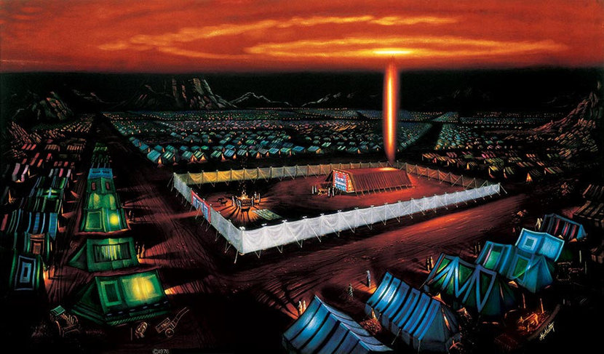

Slide 2
And it shall be a statute to you forever that in the 7th month, on the 10th day of the month, you shall afflict yourselves and shall do no work, either the native or the stranger who sojourns among you. For on this day shall atonement be made for you to cleanse you. You shall be clean before the Lord from all your sins. It is a Sabbath of solemn rest to you, and you shall afflict yourselves; it is a statute forever. ... And this shall be a statute forever for you, that atonement may be made for the people of Israel once in the year because of all their sins.
Leviticus 16:29-34 (ESV)
For on this day shall atonement be made for you
atonement may be made for the people
of Israel once in the year

Slide 3
What is Atonement?
Atonement: covering over (sin)
Related Words:
Appeasement
Propitiation
Expiation
Ransom
This was the day when God dealt with the sin of His people, purging it away so that He could dwell in their midst.

Slide 4
Day of Atonement (Leviticus 16)
High Priest offers for himself (16:1-4, 11-13)
One goat is killed for the people (16:5-10, 15)
Blood purifies Tabernacle (16:14-19, 30-34)
Other goat carries away sin (16:5-10, 20-22)
Priests wash and change clothes (16:23-28)

Slide 5
Day of Atonement (Hebrews)
High Priest offers for himself
One goat is killed for the people
Blood purifies Tabernacle
Other goat carries away sin
Priests wash and change clothes
Limitations :
Mortal, imperfect priests
Repetitive, insufficient animal sacrifices
Jesus is the High Priest
(2:17-18; 4:14-16; 7:26 - 8:2)
We have Access (4:16; 10:19-22)
Jesus is the Sacrifice
(9:11-14, 23-28; 10:11-14)
We are Purified
(9:14, 27-28; 10:22-26)

Slide 6
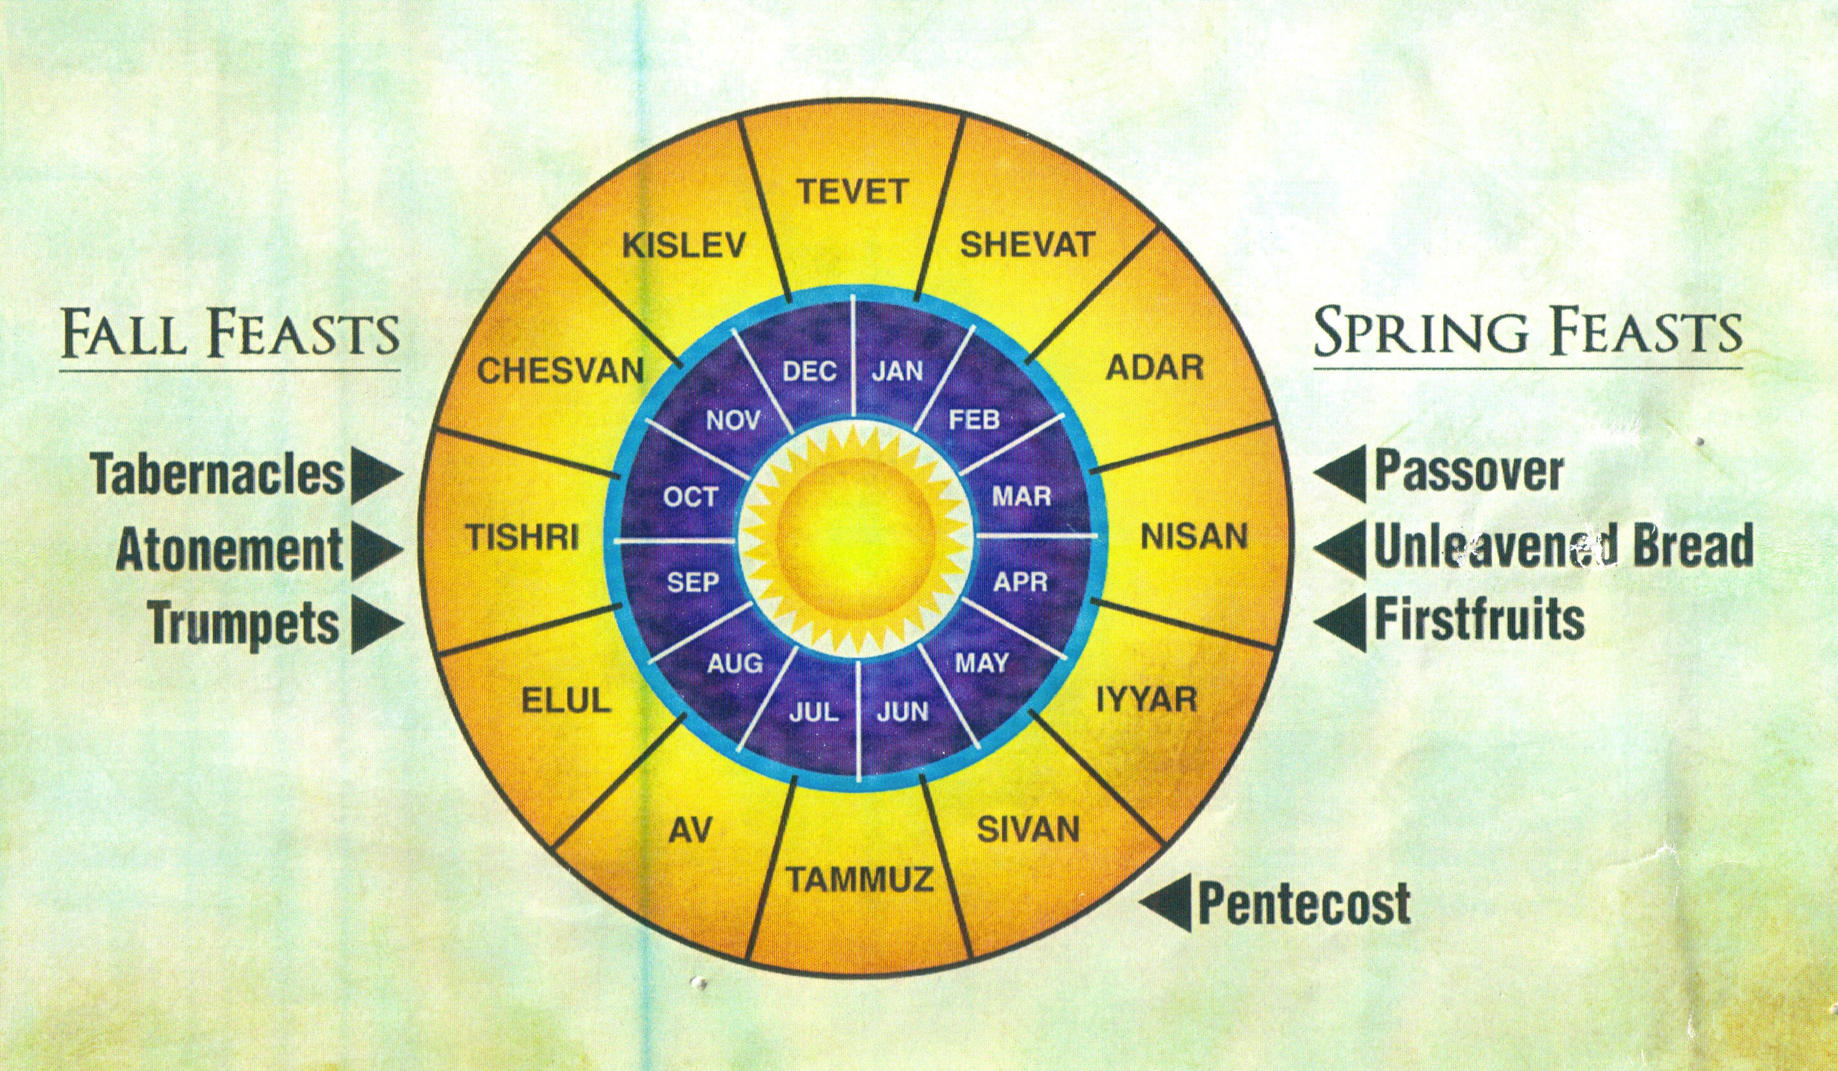
Holy Days Pointing to Jesus & His Kingdom

Slide 7
We have an altar from which those who serve the tent have no right to eat. For the bodies of those animals whose blood is brought into the holy places by the high priest as a sacrifice for sin are burned outside the camp. So Jesus also suffered outside the gate in order to sanctify the people through his own blood. Therefore let us go to him outside the camp and bear the reproach he endured. For here we have no lasting city, but we seek the city that is to come.
Hebrews 13:10-14 (ESV)
Therefore let us go to him
outside the camp

Slide 8
Jesus Our Atonement
Let us draw near … with our hearts sprinkled clean from an evil conscience, our bodies washed with pure water.

