Slide 4
He then said, “See the effect of imagination? How powerful is its influence!
Here are people who do not know me–who have never seen me; they have only heard me spoken of;
and what do they not feel! what would they not do to serve me! And the same caprice is to be found in all countries, in all ages, and in both sexes! This is fanaticism!
Yes, imagination rules the world!”

Slide 5
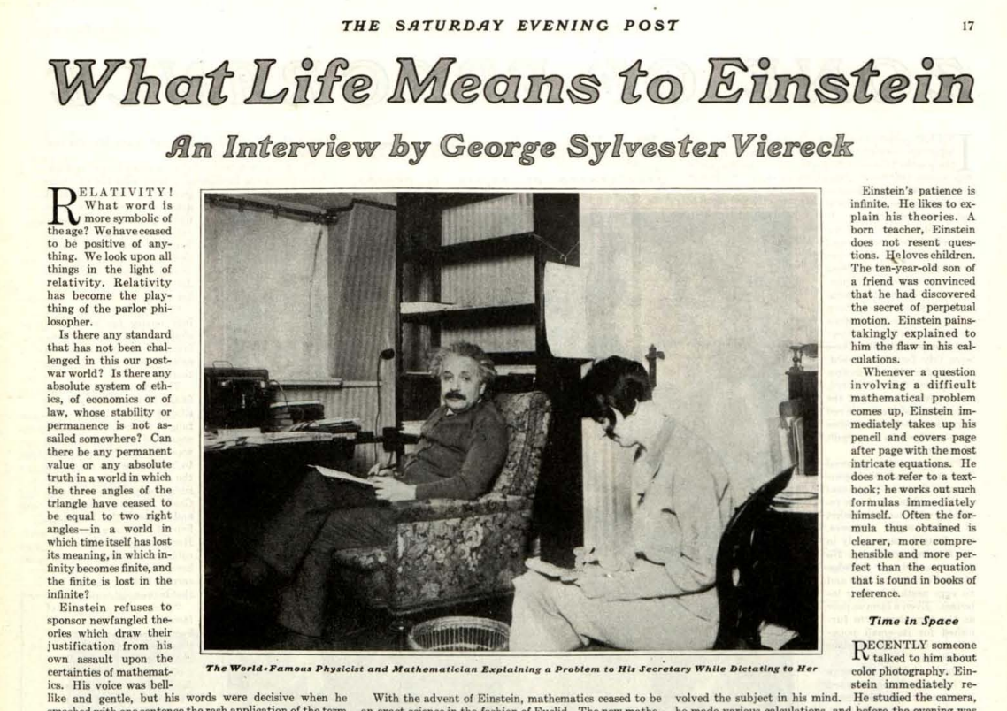

Slide 6
"Then you trust more to your Imagination than to your knowledge?
I am enough of the artist to draw freely upon my imagination.
Imagination is more important than knowledge. Knowledge is limited. Imagination encircles the world."

Slide 7
“It was the conviction of Plato, of Van Helmont, of Pascal, of Swedenborg, that piety is an essential condition of science, that great thoughts come from the heart.
It happens sometimes that poets do not believe their own poetry; they are so much the less poets. But great men are sincere.
Great men are they who see that spiritual is stronger than any material force, that thoughts rule the world.

Slide 8
Thoughts rule the world.

Slide 9
[Mat 22:36-37 NKJV] 36 "Teacher, which [is] the great commandment in the law?" 37 Jesus said to him, "'You shall love the LORD your God with all your heart, with all your soul, and with all your mind.'

Slide 10
[Rom 12:1-2 NIV] 1 Therefore, I urge you, brothers and sisters, in view of God's mercy, to offer your bodies as a living sacrifice, holy and pleasing to God--this is your true and proper worship.

Slide 11
[Rom 12:1-2 NIV] 1 Therefore, I urge you, brothers and sisters, in view of God's mercy, to offer your bodies as a living sacrifice, holy and pleasing to God--this is your true and proper worship.
2 Do not conform to the pattern of this world, but be transformed by the renewing of your mind. Then you will be able to test and approve what God's will is--his good, pleasing and perfect will.

Slide 12
[Gen 6:5 NIV] 5 The LORD saw how great the wickedness of the human race had become on the earth, and that every inclination of the thoughts of the human heart was only evil all the time.

Slide 13
[Eph 6:12-13 NIV] 12 For our struggle is not against flesh and blood, but against the rulers, against the authorities, against the powers of this dark world and against the spiritual forces of evil in the heavenly realms.

Slide 14
[Gen 3:1-6 NIV] 1 Now the serpent was more crafty than any of the wild animals the LORD God had made. He said to the woman, "Did God really say, 'You must not eat from any tree in the garden'?" 2 The woman said to the serpent, "We may eat fruit from the trees in the garden, 3 but God did say, 'You must not eat fruit from the tree that is in the middle of the garden, and you must not touch it, or you will die.' " 4 "You will not certainly die," the serpent said to the woman. 5 "For God knows that when you eat from it your eyes will be opened, and you will be like God, knowing good and evil."

Slide 15
[Gen 3:6 NIV] 6 When the woman saw that the fruit of the tree was good for food and pleasing to the eye, and also desirable for gaining wisdom, she took some and ate it. She also gave some to her husband, who was with her, and he ate it.

Slide 16
[Mat 4:3-10 NIV] 3 The tempter came to him and said, "If you are the Son of God, tell these stones to become bread.
“4 Jesus answered, "It is written: 'Man shall not live on bread alone, but on every word that comes from the mouth of God.'"

Slide 17
5 Then the devil took him to the holy city and had him stand on the highest point of the temple. 6 "If you are the Son of God," he said, "throw yourself down. For it is written: " 'He will command his angels concerning you, and they will lift you up in their hands, so that you will not strike your foot against a stone.'" 7 Jesus answered him, "It is also written: 'Do not put the Lord your God to the test.'"

Slide 18
8 Again, the devil took him to a very high mountain and showed him all the kingdoms of the world and their splendor. 9 "All this I will give you," he said, "if you will bow down and worship me." 10 Jesus said to him, "Away from me, Satan! For it is written: 'Worship the Lord your God, and serve him only.'"

Slide 19
[Eph 6:13 NIV] 13 Therefore put on the full armor of God, so that when the day of evil comes, you may be able to stand your ground, and after you have done everything, to stand.

Slide 20
[Col 3:1-3 NIV] 1 Since, then, you have been raised with Christ, set your hearts on things above, where Christ is, seated at the right hand of God. 2 Set your minds on things above, not on earthly things. 3 For you died, and your life is now hidden with Christ in God.

Slide 21
[Rom 12:1-2 NIV] ….Then you will be able to test and approve what God's will is--his good, pleasing and perfect will.

Slide 22
Thoughts rule the world.
[Rom 12:2 NIV] 2 Do not conform to the pattern of this world, but be transformed by the renewing of your mind….

