Slide 1
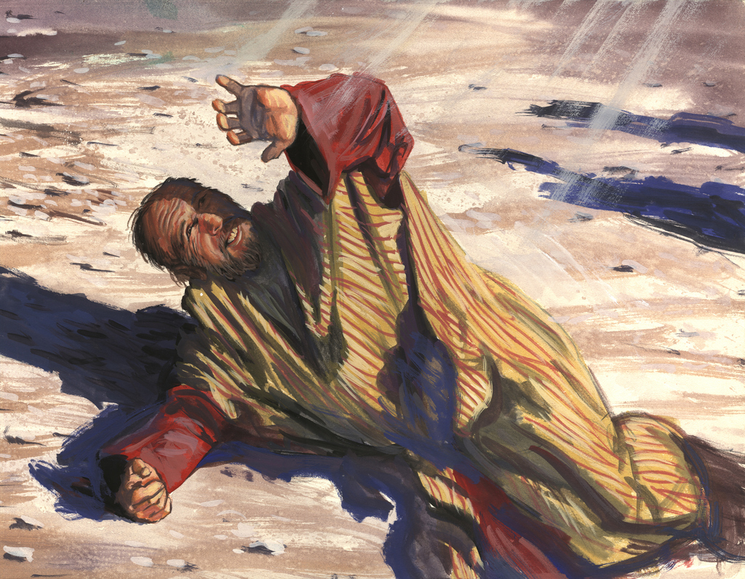
Saul’s Transformation
Acts 9:1-30; 22:1-21; 26:12-18

Slide 2
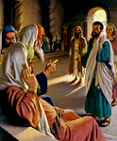
Saul’s Transformation
Before His Conversion
Very Religious
A Pharisee - Acts 23:6
Philippians 3:4-6 (NKJV) ⁵ circumcised the eighth day, of the stock of Israel, of the tribe of Benjamin, a Hebrew of the Hebrews; concerning the law, a Pharisee; ⁶ concerning zeal, persecuting the church; concerning the righteousness which is in the law, blameless.

Slide 3
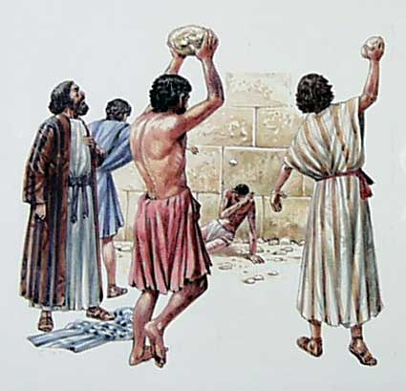
Conversion of Saul From Tarsus
Before His Conversion – He Lived For One Purpose
Enemy - Persecutor
Acts 7:58 - An accomplice
Acts 8:1-3 - Havoc of church / prison
Acts 9:1-2 - Threats & murder
Acts 22:4-5 – Death
Acts 26:9-11 - “Enraged against them”
A Man Who Lives for one purpose to Uphold a False and Damning Religion

Slide 4
Saul’s Transformation
Jesus said, “I Am the Way!”
We must understand the darkness of his past, if we are to understand his gratitude for the Grace that transformed him.
Saul of Tarsus was washed, he was sanctified, he was justified in the name of the Lord Jesus Christ and by the Spirit of our God!

Slide 5
Saul’s Transformation
Jesus said, “I Am the Way!”
1. The transformation of a man begins with a Trusting Faith in Christ.
It was the narrowness of Christianity that Saul understood and hated!

Slide 6
Saul’s Transformation
Jesus said, “I Am the Way!”
The confident terrorist in Jerusalem, who was blind, but thought he saw, was now on the Damascus Road a broken and blind man who could finally see.
Notes:
Conversion Of The Ethiopian Eunuch
by David Padfield
In the eighth chapter of the book of Acts we find one of the many cases of conversion in the New Testament. These examples have been recorded for us to demonstrate how men enter the kingdom of God. Like every other case of conversion in Acts, God used the "foolishness of preaching" (1 Corinthians 1:21) to reach the alien sinner. An angel of the Lord sent a preacher named Philip to teach an Ethiopian nobleman (Acts 8:26).
Little is known about the Ethiopian. In all likelihood, he was a black man who had turned to Judaism. We know he was a sincere individual, for he had traveled over 1,000 miles, from Ethiopia to Jerusalem, to worship God (Acts 8:27). It would be hard to believe a man would travel that far across the desert by chariot just for "show." I know folks who claim to love God but won't drive fifteen minutes in a new car to assemble with the saints. His dedication to God is further shown in Acts 8:28, where we find him "reading Isaiah the prophet" as he traveled.
The Ethiopian was a very humble man. When Philip drew near the chariot he asked the Ethiopian if he understood what he was reading. He replied, "How can I, unless someone guides me?" (Acts 8:31). After this, Philip got up into the chariot and "preached Jesus to him" (Acts 8:35). In the course of preaching Jesus, Philip spoke of water baptism. We know this because the Ethiopian said, "See, here is water. What hinders me from being baptized?" (Acts 8:36). Philip responded "If you believe with all your heart you may" (Acts 9:37). The man then confessed, "I believe that Jesus Christ is the Son of God."
His confession was an acknowledgment of the Lordship of Christ. In Romans 10:10 we read, "For with the heart one believes to righteousness, and with the mouth confession is made to salvation." This confession, as noble as it is, will not bring salvation by itself. "Even the demons believe -- and tremble" (James 2:19).
After his confession, "he commanded the chariot to stand still. And both Philip and the eunuch went down into the water, and he baptized him" (Acts 8:38). New Testament baptism was always by immersion in water. It is referred to as a "burial" (Romans 6:1-4). Sprinkling or pouring instead of immersion was introduced by men centuries after the completion of the New Testament. I am certain Philip was not a Baptist preacher, for you will notice that no church voted on the Ethiopian before he was baptized. When a man is saved, the Lord adds him to His church (Acts 2:47).
Furthermore, Bible baptism is "for the remission of sins" (Acts 2:38). We are baptized in order to obtain salvation. Some people have changed the divine order of things by teaching salvation comes at the point of faith, before and without water baptism. This doctrine is out of harmony with the word of God (Mark 16:16; Acts 22:16; 1 Peter 3:21). After his baptism, the Ethiopian "went on his way rejoicing" (Acts 8:39). He had good reason to rejoice, for he was now a child of God, redeemed by the blood of Christ. He was now a "new creation" (2 Cor. 5:17).
If you would like to know more about baptism and the church Jesus built, please contact us. If you do not have a Bible, we will be happy to give you one.

Slide 7
Saul’s Tranformation
Jesus Appeared & Saul Became A Transformed Man
Bright Light (9:3; 22:6; 26:13)
Voice (9:4-6; 22:7-10; 26:14-18)
Blinded (9:7-9; 22:11)
“Why persecute me?”
“I am Jesus”
“Go into city told what to do”
“Appeared to you -send to Gentles” (22:21; 26:17-20)

Slide 8
Saul’s Transformation
Jesus said, “I Am the Way!”
2. Transformation of a man continues as
long as trusting faith moves him to obey God.

Slide 9
Saul’s Transformation
2 Corinthians 11:23-28 (NKJV) ²³ Are they ministers of Christ?--I speak as a fool--I am more: in labors more abundant, in stripes above measure, in prisons more frequently, in deaths often. ²⁴ From the Jews five times I received forty stripes minus one. ²⁵ Three times I was beaten with rods; once I was stoned; three times I was shipwrecked; a night and a day I have been in the deep; ²⁶ in journeys often, in perils of waters, in perils of robbers, in perils of my own countrymen, in perils of the Gentiles, in perils in the city, in perils in the wilderness, in perils in the sea, in perils among false brethren; ²⁷ in weariness and toil, in sleeplessness often, in hunger and thirst, in fastings often, in cold and nakedness-- ²⁸ besides the other things, what comes upon me daily: my deep concern for all the churches.

Slide 10
Saul’s Transformation
In the pain of hard times Jesus will open a door and trusting faith will step through it.

Slide 11
Saul’s Transformation
One thing about Saul that never changed was his Zeal!
Titus 2:13-14
…waiting for our blessed hope, the appearing of the glory of our great God and Savior Jesus Christ, who gave himself for us to redeem us from all lawlessness and to purify for himself a people for his own possession who are zealous for good works.

Slide 12
Saul’s Transformation
Jesus said, “I Am the Way!”
Ananias said to Paul, “Arise and be baptized and wash away your sins.”
Notes:
Conversion Of The Ethiopian Eunuch
by David Padfield
In the eighth chapter of the book of Acts we find one of the many cases of conversion in the New Testament. These examples have been recorded for us to demonstrate how men enter the kingdom of God. Like every other case of conversion in Acts, God used the "foolishness of preaching" (1 Corinthians 1:21) to reach the alien sinner. An angel of the Lord sent a preacher named Philip to teach an Ethiopian nobleman (Acts 8:26).
Little is known about the Ethiopian. In all likelihood, he was a black man who had turned to Judaism. We know he was a sincere individual, for he had traveled over 1,000 miles, from Ethiopia to Jerusalem, to worship God (Acts 8:27). It would be hard to believe a man would travel that far across the desert by chariot just for "show." I know folks who claim to love God but won't drive fifteen minutes in a new car to assemble with the saints. His dedication to God is further shown in Acts 8:28, where we find him "reading Isaiah the prophet" as he traveled.
The Ethiopian was a very humble man. When Philip drew near the chariot he asked the Ethiopian if he understood what he was reading. He replied, "How can I, unless someone guides me?" (Acts 8:31). After this, Philip got up into the chariot and "preached Jesus to him" (Acts 8:35). In the course of preaching Jesus, Philip spoke of water baptism. We know this because the Ethiopian said, "See, here is water. What hinders me from being baptized?" (Acts 8:36). Philip responded "If you believe with all your heart you may" (Acts 9:37). The man then confessed, "I believe that Jesus Christ is the Son of God."
His confession was an acknowledgment of the Lordship of Christ. In Romans 10:10 we read, "For with the heart one believes to righteousness, and with the mouth confession is made to salvation." This confession, as noble as it is, will not bring salvation by itself. "Even the demons believe -- and tremble" (James 2:19).
After his confession, "he commanded the chariot to stand still. And both Philip and the eunuch went down into the water, and he baptized him" (Acts 8:38). New Testament baptism was always by immersion in water. It is referred to as a "burial" (Romans 6:1-4). Sprinkling or pouring instead of immersion was introduced by men centuries after the completion of the New Testament. I am certain Philip was not a Baptist preacher, for you will notice that no church voted on the Ethiopian before he was baptized. When a man is saved, the Lord adds him to His church (Acts 2:47).
Furthermore, Bible baptism is "for the remission of sins" (Acts 2:38). We are baptized in order to obtain salvation. Some people have changed the divine order of things by teaching salvation comes at the point of faith, before and without water baptism. This doctrine is out of harmony with the word of God (Mark 16:16; Acts 22:16; 1 Peter 3:21). After his baptism, the Ethiopian "went on his way rejoicing" (Acts 8:39). He had good reason to rejoice, for he was now a child of God, redeemed by the blood of Christ. He was now a "new creation" (2 Cor. 5:17).
If you would like to know more about baptism and the church Jesus built, please contact us. If you do not have a Bible, we will be happy to give you one.

Slide 13
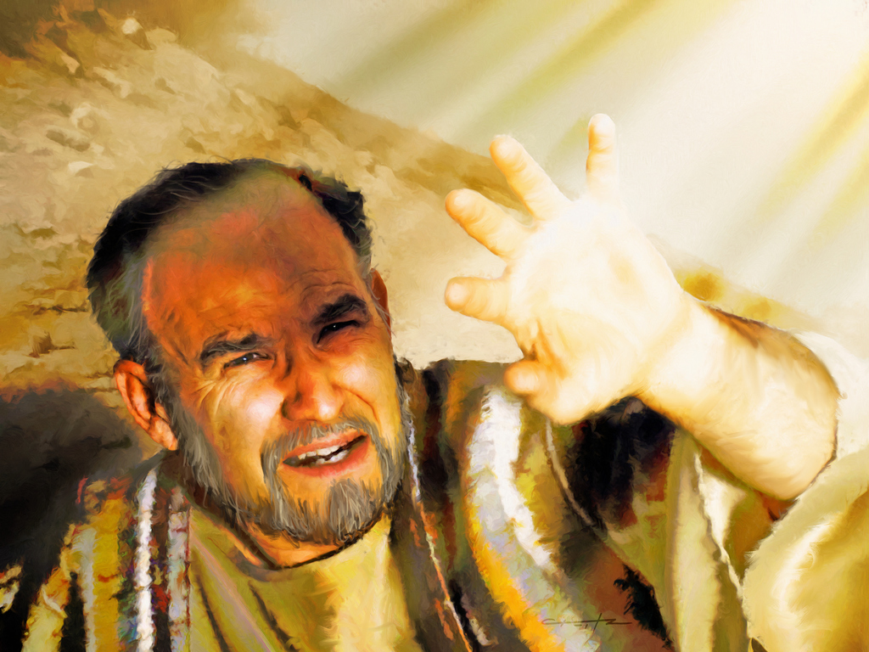
Have You Obeyed the Gospel?
Do you believe that Jesus is the Christ, the Son of the Living God? John 8:24
Have you confessed Jesus as the Christ? Rom 10:9-10
Have you repented and been baptized having your sins washed away? (Acts 22:16; 2:38; Luke 13:3-5)
Are you zealously serving the Lord? (Titus 2:13-14)

Slide 14
Saul’s Transformation
Acts 9:1-30; 22:1-21; 26:12-18

