Slide 1
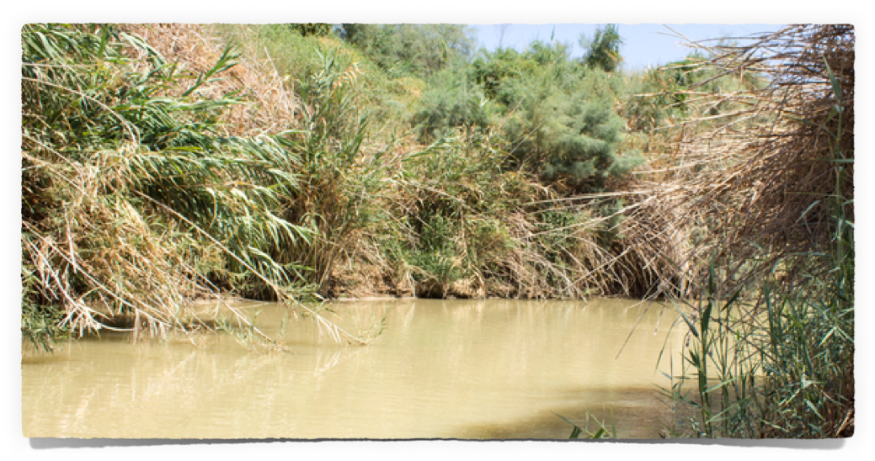
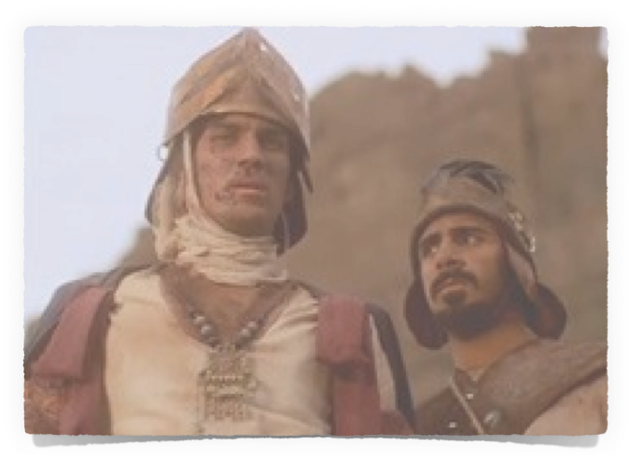
Naaman’s Great Expectations
Isa 55:8-9
Isaiah 55:8-9 says, “For My thoughts are not your thoughts, Nor are your ways My ways,” declares the Lord. For as the heavens are higher than the earth, So are My ways higher than your ways And My thoughts than your thoughts.”

Slide 2
Naaman’s Great Expectations
2 Kings 5:1 (NKJV)
¹ Now Naaman, commander of the army of the king of Syria, was a great and honorable man in the eyes of his master, because by him the LORD had given victory to Syria. He was also a mighty man of valor, but a leper.

Slide 3
Naaman’s Great Expectations
2 Kings 5:7 (NKJV)
⁷ And it happened, when the king of Israel read the letter, that he tore his clothes and said, "Am I God, to kill and make alive, that this man sends a man to me to heal him of his leprosy? Therefore please consider, and see how he seeks a quarrel with me."

Slide 4
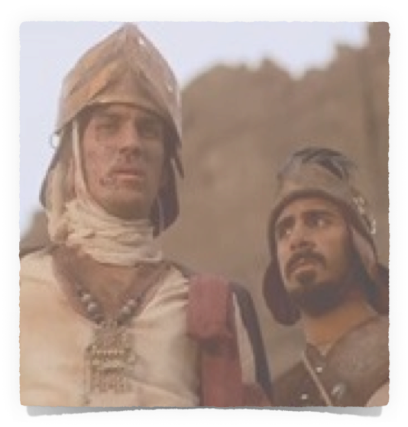
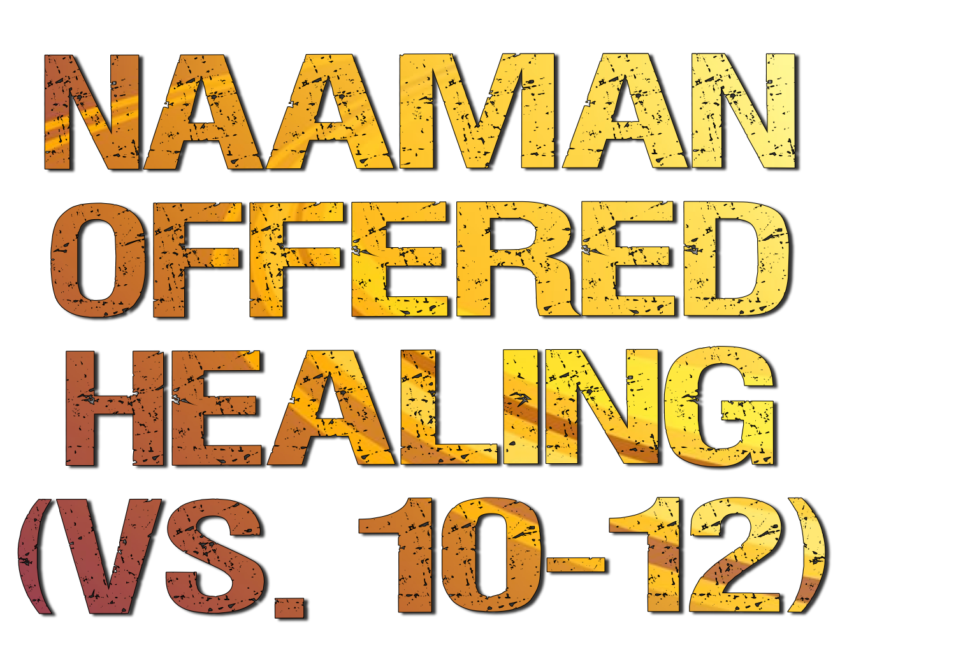
Naaman’s Great Expectations
Elisha sends a servant out to Naaman – (10a)
Naaman is told to "Go and wash in the Jordan seven times, and your flesh shall be restored to you, and you shall be clean." – (10b)
Naaman became furious – (11) because God’s plan didn’t fit his plan “behold I thought!”
“BEHOLD I THOUGHT” SYNDROME

Slide 5
Naaman’s Great Expectations
OUR EXPECTATIONS CAN ROB OUR JOY & HOPE
“BEHOLD I THOUGHT”

Slide 6
2 Kings 5:1 (NKJV)
¹ Now Naaman, commander of the army of the king of Syria, was a great and honorable man in the eyes of his master, because by him the LORD had given victory to Syria. He was also a mighty man of valor, but a leper.

Slide 7
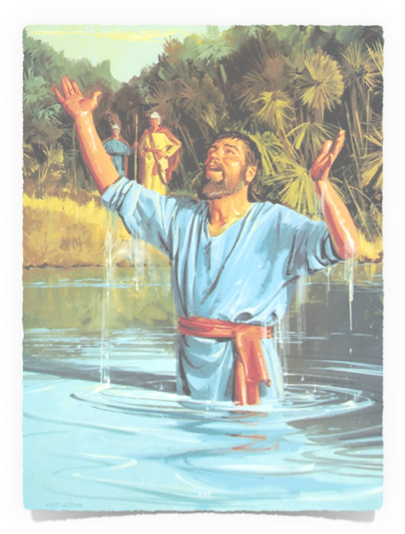
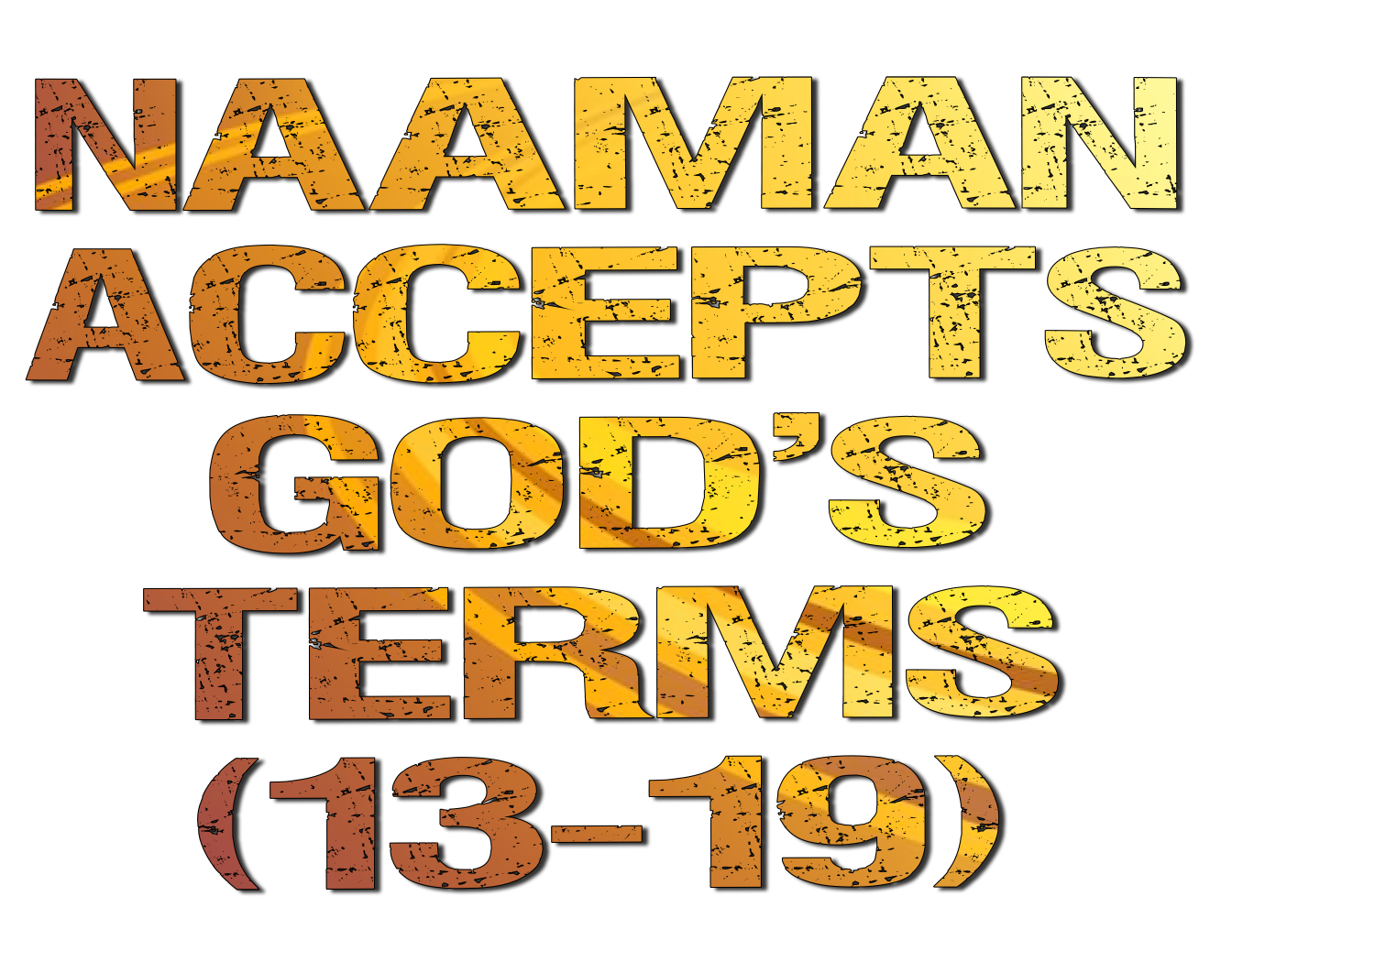
Naaman’s Great Expectations
Naaman is approached by his servants - “If the prophet had told you to do some great thing would you not have done it?”– (13)
Naaman humbles himself, obeys God’s instructions & receives God’s gift of being healed – (14)

Slide 8
Naaman’s Great Expectations
Naaman nearly rejected the prospect of physical healing because the conditions did not conform to his expectations (2 Kings 5:1-14).
In the same way, many reject God’s terms of spiritual healing as expressed through the gospel . (Acts 2:36-38; 22:6-16; Gal. 3:26-27; 1 Pet. 3:20-21).
“BEHOLD I THOUGHT” SYNDROME

Slide 9
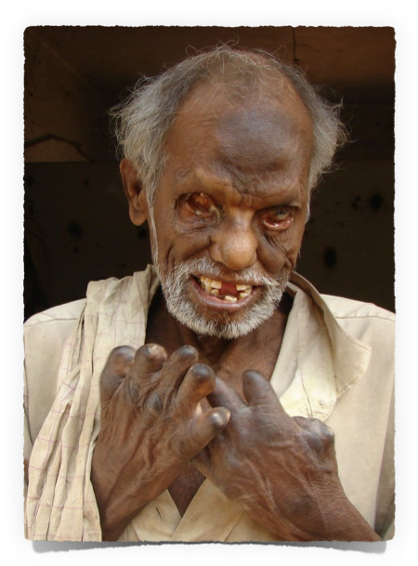
Naaman’s Great Expectations
Sin, like leprosy in Bible times, is incurable by man.
Sin, like leprosy, is loathsome & defiling –
Sin, like leprosy, causes separation –
Sin, like leprosy, unless cured - causes death -

Slide 10
Naaman’s Great Expectations
God has offered salvation from sin through His Son Jesus Christ - (Mat 11:28-30; Mk 16:16; John 8:24; Acts 2:38; 22:16)
No substitute for God’s way will cleanse us from our sins! - (2 Thes 1:7-9)
Why are people today so resistant to God’s way?

Slide 11
Naaman’s Great Expectations
Because God’s conditions do not conform to their expectations – opinions, tradition, or selfish desire.
“Behold I thought” Syndrome!

Slide 12
Naaman’s Great Expectations
Acts 22:16 (NKJV) ¹⁶ And now why are you waiting? Arise and be baptized, and wash away your sins, calling on the name of the Lord.'

