Slide 1
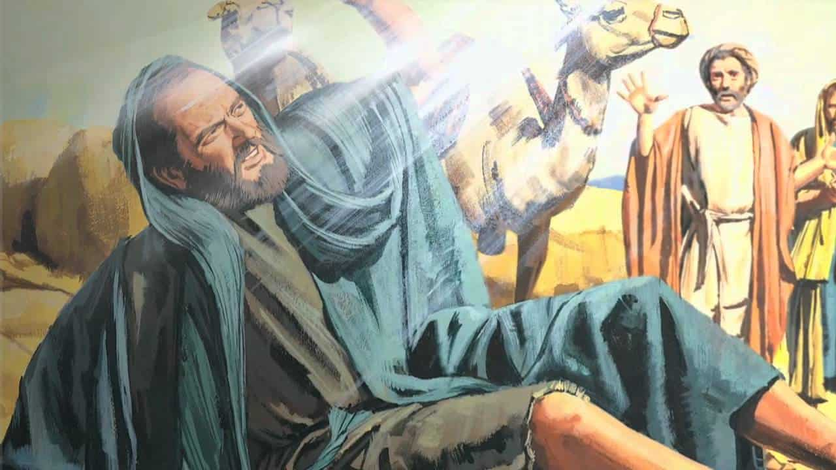
The Apostle Paul - Once Saul

Slide 2
Vs.11. - And such were some of you. But you were washed, you were sanctified, you were justified in the name of the Lord Jesus Christ and by the Spirit of our God.
Can the Ethiopian change his skin, or the leopard his spots? Jer. 13:23
For though thou wash thee with lye, and take thee much soap, yet thine iniquity is marked before me, saith the Lord Jehovah. Jer. 2:22
Crush a fool in a mortar with a pestle
along with crushed grain,
yet his folly will not depart from him. Prov. 27:22

Slide 3
Jer. 17:9 “The heart of man is deceitful above all things and desperately wicked. Who can know it?”
Isaiah 1:5-6 “Man is sick from the top of his head to the sole of his feet, and everywhere in-between.”
1. In a transformed life there is a clear introduction to Christ.
How then will they call on him in whom they have not believed? And how are they to believe in him of whom they have never heard? And how are they to hear without someone preaching? Romans 10:14

Slide 4
Therefore, if anyone is in Christ, he is a new creation. The old has passed away; behold, the new has come. 2 Cor. 5:17
The one who is dead in sins becomes alive to righteousness.
The one who is ignorant of truth becomes wise in divine truth.
The one who is insensitive to divine presence now tastes and sees that the Lord is good.
The one who is blind can now see.
The one who is in darkness is in the blazing light.
The one who belonged to the kingdom of Satan belongs to the kingdom of God’s dear Son.

Slide 5
The one who did evil continually now finds the cry of his heart is to do that which is good.
The one who didn’t even know what the questions were now has all the answers.
The one who is bound for hell is bound for heaven.
The one who hated God now loves God.
The one who loved sin now hates sin.
The rebel is a son; the enemy is a friend.

Slide 6
Therefore, if anyone is in Christ, he is a new creation. The old has passed away; behold, the new has come. 2 Cor. 5:17
2. Someone who is transformed, enters into a dependence and communion with God.
Prayer is simply the soul of a Christian moving under the pressure of the presence of God.
So, Ananias departed and entered the house. And laying his hands on him he said, “Brother Saul, the Lord Jesus who appeared to you on the road by which you came has sent me so that you may regain your sight and be filled with the Holy Spirit.” And immediately something like scales fell from his eyes, and he regained his sight. Then he rose and was baptized; and taking food, he was strengthened. Acts 9:17-19

Slide 7
3. Evidence of Transformation is a desire to Serve others and it becomes a priority of life.
A transformed life starts with faith in the Word of God.
Communion with the living God.
Service in the Kingdom.
4. Led by the Holy Spirit.
“You shall be filled with the Holy Spirit in order that you might do the ministry you’re called to do.”

Slide 8
Romans 8:9-11
You, however, are not in the flesh but in the Spirit, if in fact the Spirit of God dwells in you. Anyone who does not have the Spirit of Christ does not belong to him. But if Christ is in you, although the body is dead because of sin, the Spirit is life because of righteousness. If the Spirit of him who raised Jesus from the dead dwells in you, he who raised Christ Jesus from the dead will also give life to your mortal bodies through his Spirit who dwells in you.

Slide 9
Spirit-filled husbands treat their wives in a Godly fashion.
Spirit-filled wives treat their husbands based on God’s Word.
Spirit-filled parents care for their children properly.
Spirit-filled children obey their parents.
Spirit-filled managers take care of their employees.
Spirit-filled servants honor their masters.

Slide 10
Saul’s Transformation

