Slide 1
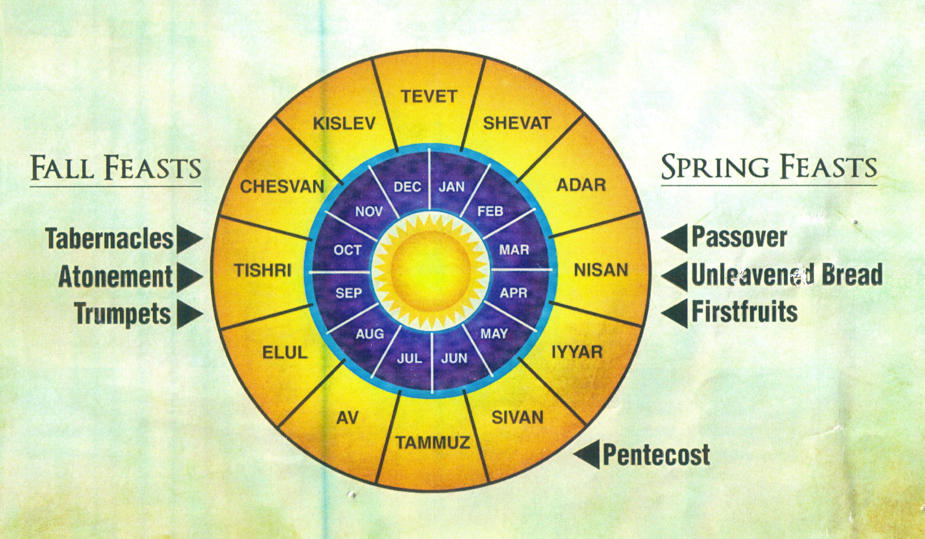
Barley
Olives/ Grapes
Wheat

Slide 2
Christ the First Fruits
Gratitude, Trust, and Life

Slide 3
What is First Fruits? (Leviticus 23)
Takes place the Sunday after Passover
The first of the year’s barley harvest
A sheaf is waved before the Lord
Burnt offering and grain offering
After this, free to eat the new growth

Slide 4
Principles in the First Fruits
The first belongs to God
Are we offering God the first portion?
Offering the first requires trust
Do we trust God enough to prioritize?

Slide 5
Christ the First Fruits
Romans 8:32 He who did not spare His own Son, but delivered Him over for us all, how will He not also with Him freely give us all things?

Slide 6
Christ the First Fruits
1 Corinthians 15:20 But now Christ has been raised from the dead, the first fruits of those who are asleep. …In Christ, all will be made alive … Christ the first fruits, after that those who are His at His coming.

Slide 7
Christ the First Fruits
Thanks be to God, who gives us the victory through our Lord Jesus Christ!

