Slide 1
REJOICE & LIVE GOODNESS IN YOUR YOUTH!
-Ecclesiastes

Slide 3
1. Enjoy Life
“Truly the light is sweet, and it is pleasant for the eyes to behold the sun”.

Slide 4
“I tried wisdom and it is better as far as light exceeding darkness. But when a person dies a wise man, he is as dead as the foolish man!”
“I tried mirth, and material gain”!
“You name it and I have tried it and I have discovered this:
“When I look at a dead body whether of a man or an animal they both look dead to me”.
“There does not appear to be any difference!”

Slide 5
1. Enjoy Life
²⁴ There is nothing better for a person than that he should eat and drink and find enjoyment in his toil. This also, I saw, is from the hand of God, Ecclesiastes 2:24

Slide 6
¹⁶ And he told them a parable, saying, “The land of a rich man produced plentifully, ¹⁷ and he thought to himself, What shall I do, for I have nowhere to store my crops?’ ¹⁸ And he said, ‘I will do this: I will tear down my barns and build larger ones, and there I will store all my grain and my goods. ¹⁹ And I will say to my soul, “Soul, you have ample goods laid up for many years; relax, eat, drink, be merry.”’ ²⁰ But God said to him, Fool! This night your soul is required of you, and the things you have prepared, whose will they be?’ ²¹ So is the one who lays up treasure for himself and is not rich toward God.” Luke 12:16-21

Slide 7
¹⁰ I have seen the business that God has given to the children of man to be busy with. ¹¹ He has made everything beautiful in its time. Also, he has put eternity into man's heart, yet so that he cannot find out what God has done from the beginning to the end. ¹² I perceived that there is nothing better for them than to be joyful and to do good as long as they live; ¹³ also that everyone should eat and drink and take pleasure in all his toil—this is God's gift to man. Ecclesiastes 3:10-13

Slide 8
¹⁸ Behold, what I have seen to be good and fitting is to eat and drink and find enjoyment in all the toil with which one toils under the sun the few days of his life that God has given him, for this is his lot. ¹⁹ Everyone also to whom God has given wealth and possessions and power to enjoy them, and to accept his lot and rejoice in his toil—this is the gift of God. ²⁰ For he will not much remember the days of his life because God keeps him occupied with joy in his heart. Ecclesiastes 5:18-20

Slide 9
⁷ Go, eat your bread with joy, and drink your wine with a merry heart, for God has already approved what you do.⁸ Let your garments be always white. Let not oil be lacking on your head. ⁹ Enjoy life with the wife whom you love, all the days of your vain life that he has given you under the sun, because that is your portion in life and in your toil at which you toil under the sun. ¹⁰ Whatever your hand finds to do, do it with your might, for there is no work or thought or knowledge or wisdom in Sheol, to which you are going. Ecclesiastes 9:7-10

Slide 10
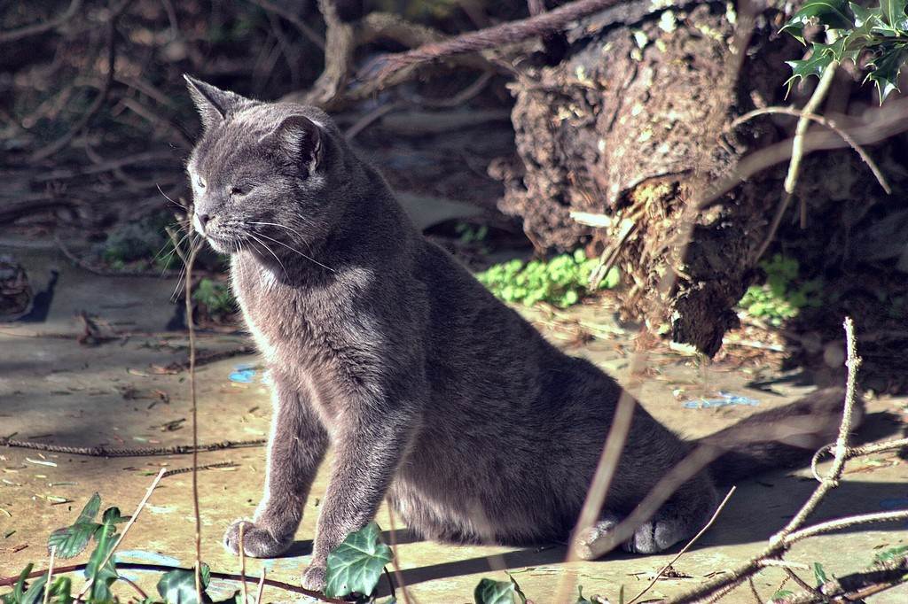
Thomas Magnum

Slide 11
⁷ Light is sweet, and it is pleasant for the eyes to see the sun.⁸ So if a person lives many years, let him rejoice in them all; but let him remember that the days of darkness will be many. All that comes is vanity. ⁹ Rejoice, O young man, in your youth, and let your heart cheer you in the days of your youth. Walk in the ways of your heart and the sight of your eyes. But know that for all these things God will bring you into judgment. Ecclesiastes 11:7-9

Slide 12
2. Enjoy Life But Remember Judgment
“Light is sweet, but there will be many dark days.”
“What about going to movies or watching TV – spending your free time playing games on your computer and TV?”
TRIVIALITIES!
Enjoy life, but with some restraints!
Remember the judgment we know is coming!

Slide 13
This passage teaches us our ways matter to God and that we must realize that judgment is a fact of life!
Enjoy life but remember judgement!
Goodness robs Joy of nothing but its hollowness!

Slide 14
REJOICE AND LIVE GOODNESS IN YOUR YOUTH!
-Ecclesiastes

