Slide 1
8. fathers “discouraging,” “provoking to wrath”
“Fathers, provoke not your children, that they be not discouraged” -Col. 3.21
“fathers, provoke not your children to wrath: but nurture them in the chastening and admonition of the Lord” -Eph.6.4
criticism … or nothing
expecting talents beyond their capacity
fluctuating boundaries based on your mood [Illust.: cattle fence]

Slide 2
9. failing to parent with joy
rejoice in the wife of your youth. Prov. 5.18
The father of the righteous will greatly rejoice; And he ...will have joy of him. Let your father and your mother be glad, And let her rejoice who gave birth to you. Prov. 23.24-25
A joyful heart makes a cheerful face, But when the heart is sad, the spirit is broken... a cheerful heart has a continual feast… Better is a dish of vegetables where love is Than a fattened ox served with hatred. Prov. 15.13-17nasb
the law of kindness is on her tongue. Prov.31.26
A joyful heart is good medicine, but a crushed spirit dries up the bones. Prov. 17.22esv
Ga.5.22 Love, Joy, Peace…

Slide 3
10. failing to use rod AND reproof
Just rod? [learns… what?]
Just reproof? [kid at walmart]
value in “the lecture”
conscience
anticipation
“The rod and reproof bring wisdom, but a child who gets his own way brings shame to his mother” Prov. 29.15

Slide 4
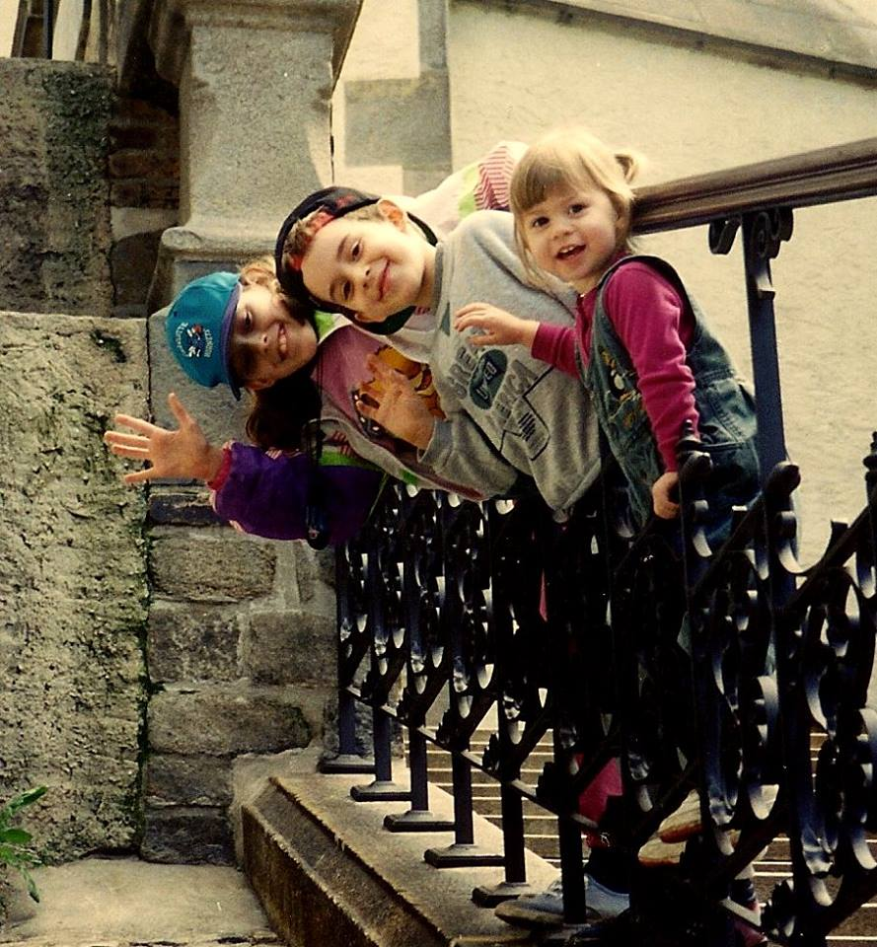
11. Settling for situation control instead of training the child.
twinkie brat - Michael & Debbie Pearl / To Train up a Child
BRIANNE & THE CAR SEAT ILLUSTRATION
A mom’s comment on this point: “life altering experience” in 2 or 3 days: improved behavior / happier child
MERE CONTROL vs. TRAINING (& what results?) “They’re not going to do that under my roof” is not enough. Train them. Teach them self-control so they will behave themselves under any roof.
“TRAIN up a child in the way he should go, even when he is old he will not depart from it” Pr.22.6 (not just “control”)
TRAIN THEIR HEARTS
a little boy, made to sit down, had this to say: “I’m still standing up on the inside!” … then job’s not done!

Slide 5
12. Mistaking “taking them to church” for “bringing them up in the nurture and admonition of the Lord”
Eph. 6.4
Deut. 6.7
“You shall teach them diligently to your sons and shall talk of them when you sit in your house and when you walk by the way and when you lie down and when you rise up”

Slide 6
13. thinking “if we don’t allow this, they might rebel and leave the church”
what good is being “in church” if they aren’t in the Lord? -Rev.3.14ff
“do you not know that friendship with the world is hostility toward God?” -James 4.4
entertainment? attire? interests?
And start training EARLY

Slide 7
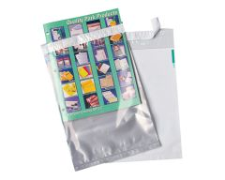
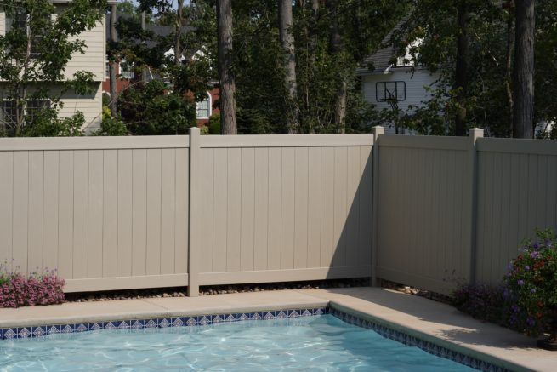
clothing choices:
clothing choices…
Gen. 3
Ex. 28:42
1 Tm. 2:9
Jn. 21.7
Pr. 7.10
1 Ptr. 3.3

Slide 8
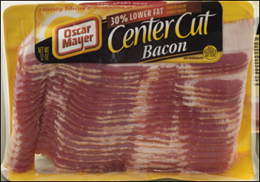
clothing choices…
exposed cleavage?
exposed undergarments?
tight pants?
tight tops?
high slits?
bare midriff?
bare thighs?

Slide 9
14. assuming cultural norms : “terrible 2’s” > “rebellious teens”
culturally common: >rebellious teens
also common: >ungodly adults
Josiah 2 Chron. 34.1-3
Timothy Acts 16:1-3 / cf. 1Tim.4.12
Note: wise parenting & the consideration of “trajectory” [cf: Jonadab in Jer.35 / Lot in Gn.13]
Expect Train Guide Eccl.12.1

Slide 10
15. Going into defense mode when our children are wrong
Defending
Denying
Redirecting blame
1Tim.5.21 “without partiality”
Isaiah 5.20 “woe to them that call evil good, and good evil”
If you start a pattern of bailing out, don’t be surprised it they come to expect it.

Slide 11
16. Failing to train humility
Proverbs 6 (first abomination)
being aware of a culture that celebrates youth and lacks respect for its elders
The fool test (prov.)

Slide 12
17. Focusing on home income ($) over home outcome (the children)
“Better is a little with the fear of the Lord than great treasure and turmoil with it. Better is a dish of vegetables where love is than a fattened ox served with hatred” Prv. 15.17
the home, not the house / the family, not the stuff
Do our homes reflect scriptural priorities? Or cultural priorities? older women: “train the young women to love their husbands, to love their children, to be sober minded, chaste, workers at home, kind, being in subjection to their own husbands” Titus 2:3-5

Slide 13
1Tim. 6:6-10

Slide 14
18. underestimating threats
corruption from the entertainment media
corruption from the internet (pornography , etc.)
offenders / predators (old and young)
certain educational agendas (relativism, promotion of homosexuality, evolution)
presuming medication solutions for behavior issues
feminism agendas & blurring of gender roles
declining standards of self-responsibility, conduct, dress, ethics, etc.

Slide 15
19. Lowering the bar from the firstborn to the baby
Lk. 15, note the birth order
not always, not necessary, but also not uncommon
why so? (in addition to time %):
pacifier illustration
1st born > into world of adults
youngest > world of children
time 1st born: parents eager
youngest: “my baby”

Slide 16
Temperament
TEMPERAMENT
“pleaser” vs. “strong-willed”
GAL.5:16ff
selfish stubbornness needs to be broken, but principled independence is very valuable
win…
…& your child wins

Slide 17
PARENTS
Take the time…
Teach them to do right
Train them to do right
EXPECT THEM TO DO RIGHT

