Slide 1
avoiding upside down homes

Slide 2
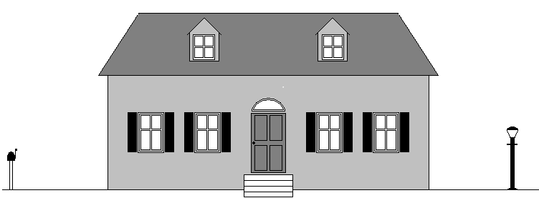
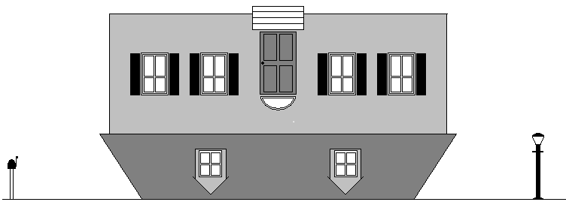

Slide 3
UPSIDE DOWN HOMES (M.&.D.Pearl?)
Child centered homes vs. God centered homes:
Too many children view the home, the parents, the food, etc., as merely a means to an ends: to satisfy and please the child.
The child makes his demands and manipulates the parents via tantrums and repeated misbehavior.
Parents bow to the will of the child in efforts to placate and appease his whims and dissatisfactions, or suffer through increased strife and conflict when they cannot.
The home is like a house built upside down.

Slide 4
The child needs to understand:
CHILD
PARENTS
GOD
GOD
father
mother
child

Slide 5
what children do need:
Titus 2.4
DT. 6.7
PR.
13.24
PR. 1.8; 13.24; 22.6
JOSH.
24.15

Slide 6
Homes (like houses) need work & maintenance

Slide 7
the relative importance of temporary threats & eternal threats…

Slide 8
a Q for the dads

Slide 9
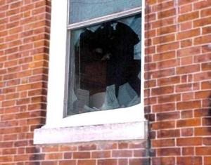
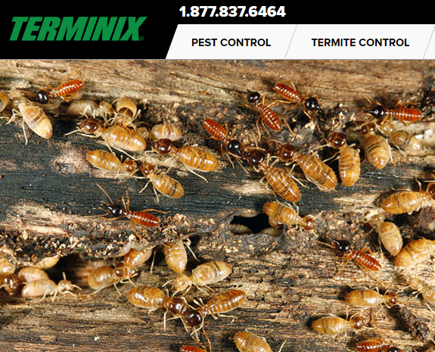
What would I do …?

Slide 10
on a spiritual & moral level… …am I letting toxic filth infiltrate my home?

Slide 11
Godliness does not come from taking our cues from the world Rm.12.1-2

Slide 12
a child untrained . . . a.) 4 yr. old b.) breakfast
Prov. 29:15
The rod and reproof give wisdom,
but a child left to himself brings
shame to his mother.

Slide 13
some common mistakes to avoid
parenting pitfalls

Slide 14
1. failing to discipline...
He who spares his rod hates his son, but he who loves him disciplines him diligently Prov.13.24
Discipline your son while there is hope, and do not desire his death Prov. 19.18
Foolishness is bound up in the heart of a child; the rod of discipline will drive it far from him Prov. 22.15

Slide 15
1. failing to discipline...
Do not hold back discipline from the child, Although you strike him with the rod, he will not die Prov. 23.13
The rod and reproof bring wisdom, but a child who gets his own way brings shame to his mother Prov. 29.15
Correct your son, and he will give you comfort; he will also delight your soul Prov. 29.17
(illustration / 4 yr. old)

Slide 16
2. Rewarding misbehavior
Why do children throw tantrums?
lowering the bar / accom. & facilitating misbehavior
letting a child get “his way” is not doing him a favor, it will spoil him
letting a child get his way will not satisfy him, it will spoil him [imp.of boundaries/ playground.ex.]
the difference between a boy and a pig
“The rod and reproof bring wisdom, but a child who gets his own way brings shame to his mother” Prov. 29.15

Slide 17
3. Expecting misbehavior
Not talking about wanting misbehavior, hoping for, or preferring misbehavior…
but expecting misbehavior
“Oh, we can’t take him to the restaurant”
“There’s no way Jr’s going to sit still for an hour”
“Well after that sugar, he’s going to be impossible”
“Oh, I’ll never get him to eat that”
“Sorry, my son’s not much of a sharer”
“Foolishness is bound up in the heart of a child; the rod of discipline will drive it far from him” Pr.22.15

Slide 18
If you expect tantrums, you will get them. If you expect dishonesty, you will get it. If you expect bad attitudes, you will get it. but if you really EXPECT the opposite, and require and TRAIN for the opposite, you will GET the opposite.
as a general rule: you get what you expect

Slide 19
4. failing to be consistent...
“He who spares his rod hates his son, but he who loves him disciplines him diligently” Pr.13.24
child pscyh. on “playing the odds”
lottery analogy: people keep buying tickets when there’s a chance of it paying off. Eliminate all lottery winnings, and people would quit buying tickets. Eliminate occasional pay-offs, and let the child realize the lottery is shut down.
“No parking” illustration (next slide)

Slide 20
Imagine a city that treated “No Parking” violations with the following sequence of responses (and everyone knew how the system worked):
10 minutes:
Please do not park here
20 minutes:
We asked you not to park here
30minutes:
I really mean it, do not park here
40 minutes:
Don’t make me tell you again
50 minutes:
I’m going to start counting to 10
60 minutes:
OK, now you’re in trouble !
$ 50 FINE
What would those no parking areas be filled with?

Slide 21
5. Thinking “I don’t have time…”
Like saying “I don’t have time to get rid of lice”
Child training time is well invested time, and saves time
“All discipline for the moment seems not joyful, but sorrowful, yet … afterwards it yields the peaceful fruit…” Heb.12.11
“He who spares his rod hates his son, but he who loves him disciplines him diligently” Prov.13.24

Slide 22
6. failing to control self...
proper motivation: Prov.13.24 “he who loves him disciplines him diligently”
discipline vs. abuse
discipline vs. YELLING!!
“expert” advice [?]
Why won’t he obey??? [
“What’s wrong with you?” “I don’t know why you won’t do right!”
the vase test (see next slide)

Slide 23
THE VASE TEST set up: a.) Jr. bounces a ball off the wall b.) Mom says: “Jr., don’t throw that ball in the house” c.) Jr. looks at mom, heard her; throws the ball again anyway.
scenario A:
nothing broken
scenario B:
antique vase is shattered
Reaction:
No big deal.
Mom says,
“Jr., I asked you not to do that.”
Reaction:
Seeing her son’s willful defiance & disobedience, Mom takes this very serious and he is punished.
WHY?
Reaction:
No big deal. Mom says, “Jr., I asked you not to do that” ?
Reaction:
Jr’s in BIG trouble!! NOW he’s going to get it! This is VERY serious.
WHY?

